Slide 1

Save your energy
Timely tips for conserving more and wasting less

Slide 2
Where does energy come from?
Electricity is a secondary energy source
  Generated from the conversion of primary sources of energy
    fossil fuels (coal, natural gas and oil),
    nuclear power and
    renewable sources (wind, hydro, solar, geothermal).

Slide 3
How is electrical energy distributed?
Electricity is generated at power plants and moves through a complex system, sometimes called the grid, of electricity substations, transformers, and power lines that connect electricity producers and consumers.
Most local grids are interconnected for reliability and commercial purposes, forming larger, more dependable networks that enhance the coordination and planning of electricity supply.

Slide 4
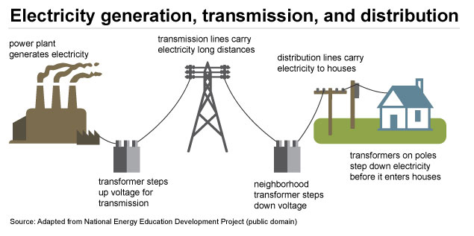
How electricity reaches your home

Slide 5
In the United States, the entire electricity grid consists of hundreds of thousands of miles of high-voltage power lines and millions of miles of low-voltage power lines with distribution transformers that connect thousands of power plants to hundreds of millions of electricity customers all across the country.

Slide 6
Why is it important to conserve energy?
The generation of electricity and heat now accounts for at least a third of global greenhouse gas (GHG) emissions.
                Source: World Resources Institute
Nonrenewable energy sources -- gas, coal, and oil -- cannot be replaced.
Lower cost of living.

Slide 7
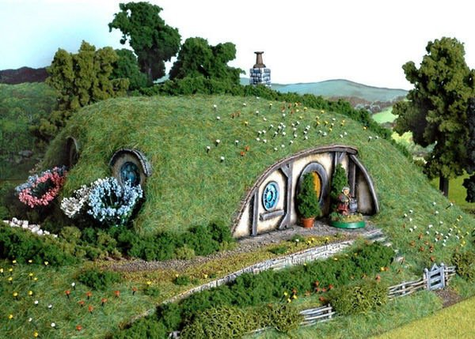
Let’s get to it.

Slide 8
Exercise – Where would you place these? Order 1 - 10
Renewable energy
Air sealing
Windows
Understanding energy usage
Water heating
Insulation
Lighting
Appliances
Unplugging electronics / Phantom Load
Heating and Cooling

Slide 9
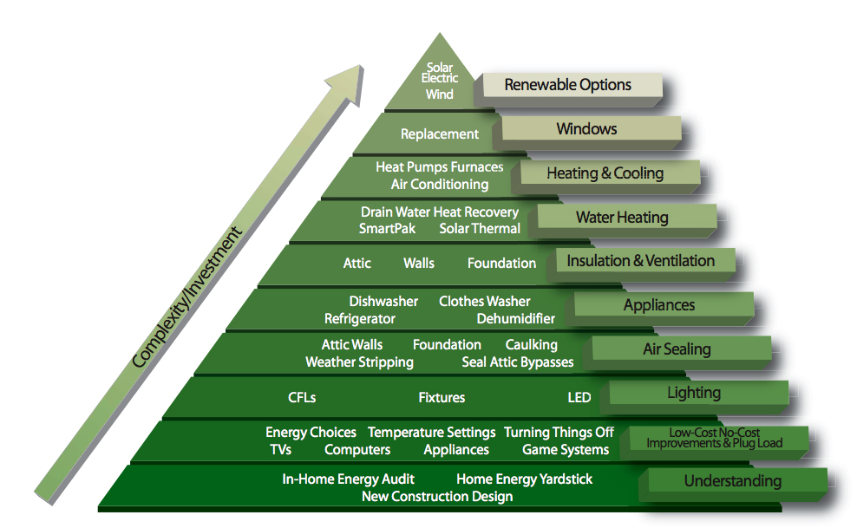

Slide 10
Home energy audit
The energy efficiency of a house is evaluated by a person using professional equipment (such as blower doors and infrared cameras), with the aim to suggest the best ways to improve energy efficiency in heating and cooling the house.

Slide 11
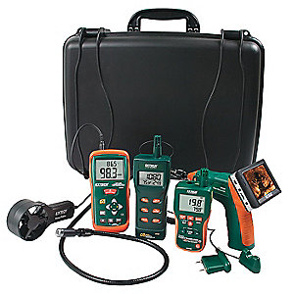
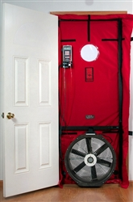
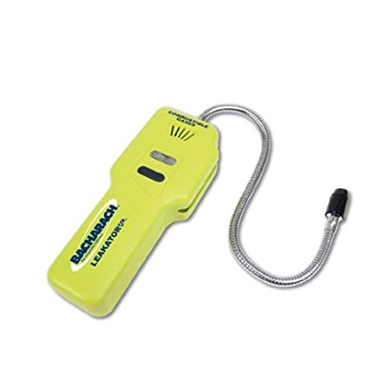
A few home energy audit tools…

Slide 12
Home energy audits
Yes, a home energy audit is a good place to start to find
  Air leaks
  Inefficient energy use or energy waste
Yes, home energy auditing is a learned skill.
Equipment and training can cost thousands of dollars.
Fortunately, you don’t have to do it yourself…

Slide 13
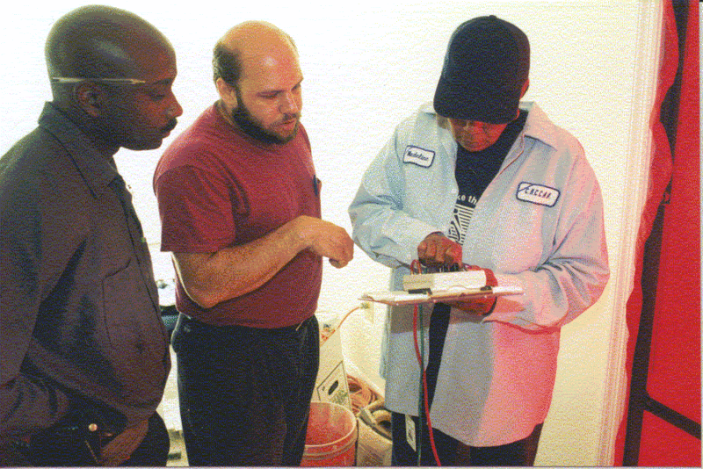
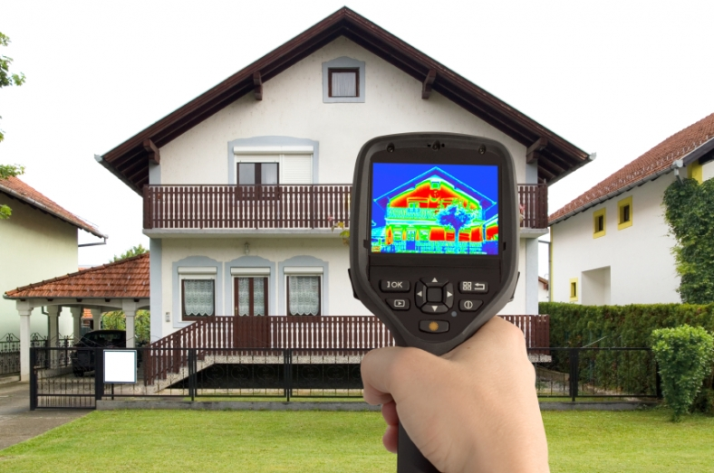
Bring in a home energy audit specialist.

Slide 14




Home energy auditors: a few examples
(check with your local utility for their audit programs and/or rebates)
betterbuildingssolutioncenter.energy.gov/

Slide 15

Now let’s look at some easy things you can do to improve your energy profile
(i.e. ,the low-hanging fruit)

Slide 16
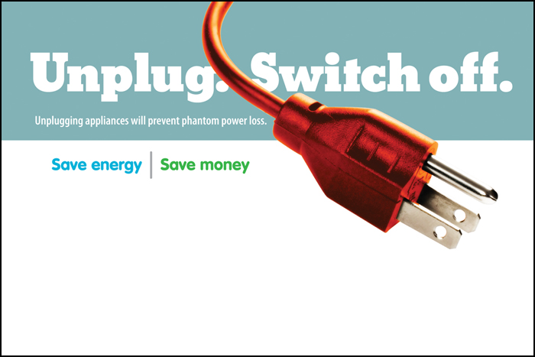

Slide 17
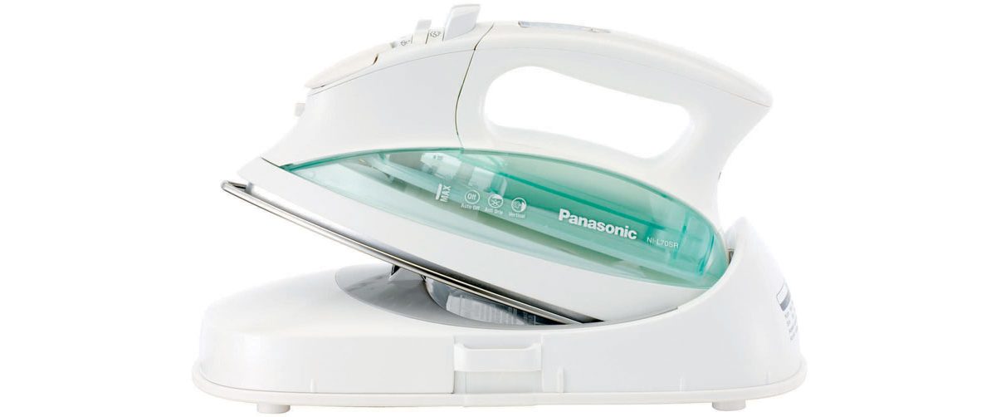
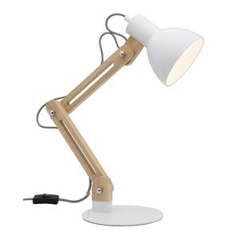

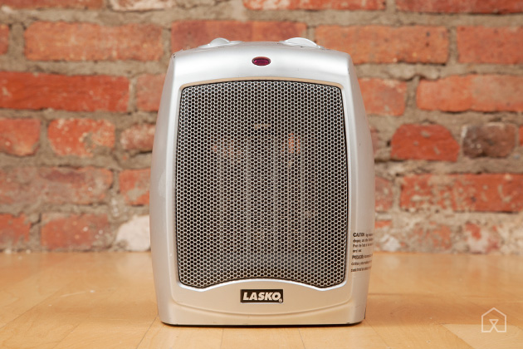
If you’re not using it, unplug it!

Slide 18
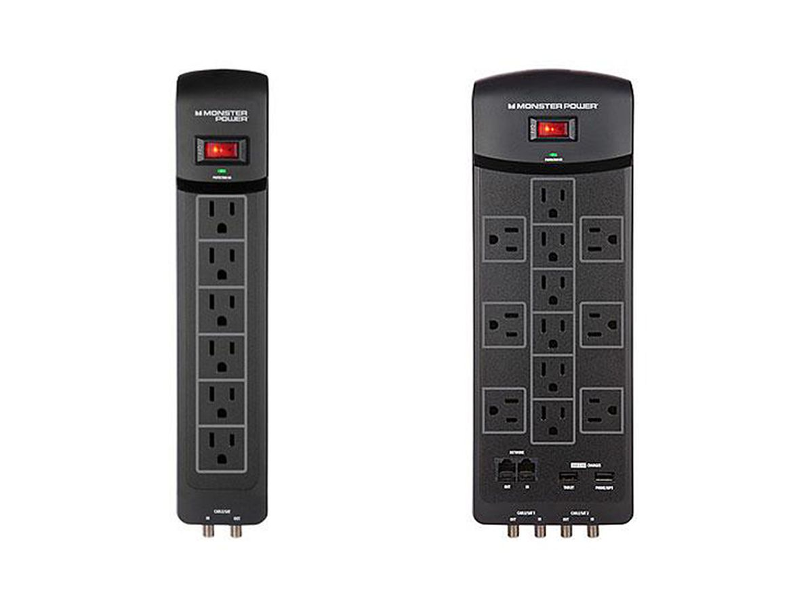
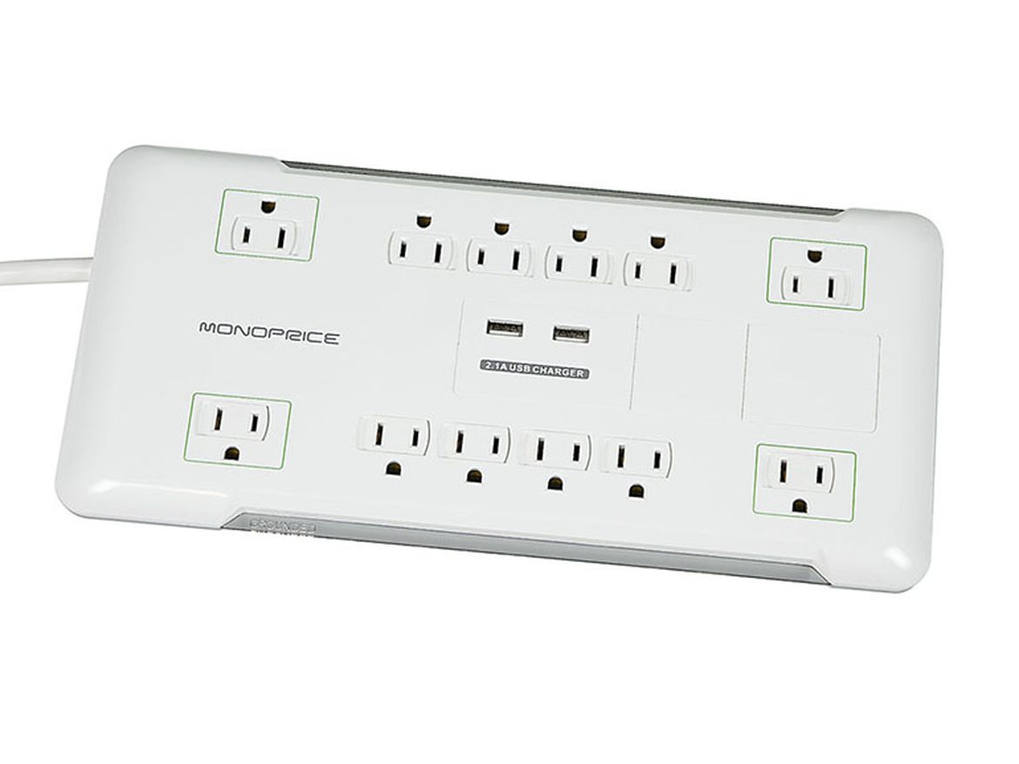
Use Surge protectors

Slide 19
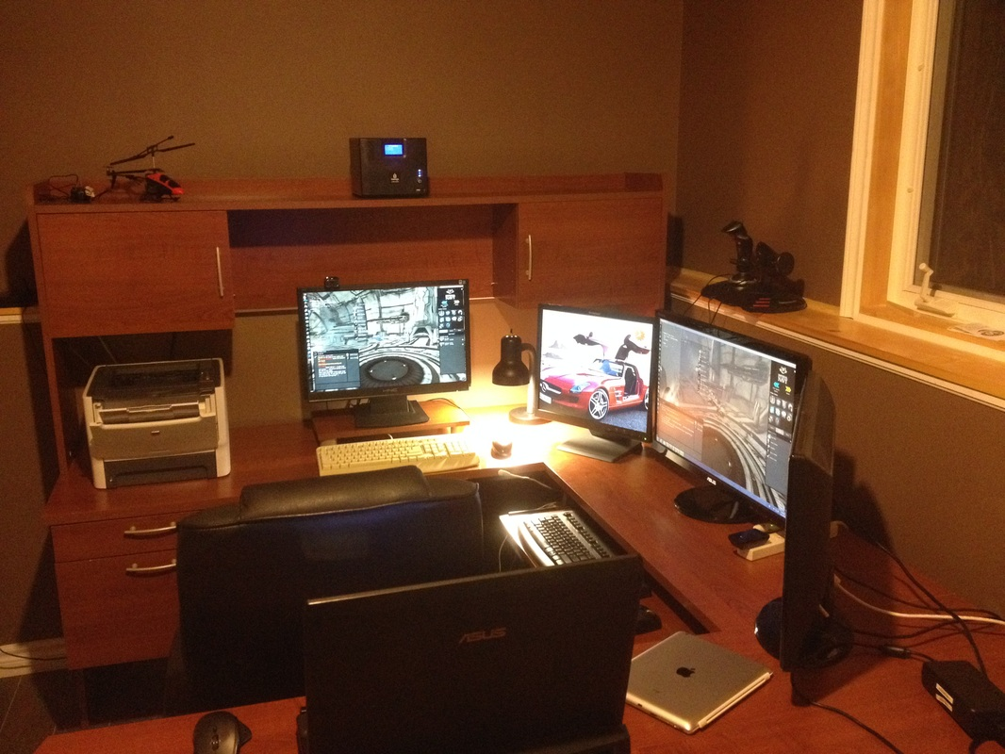
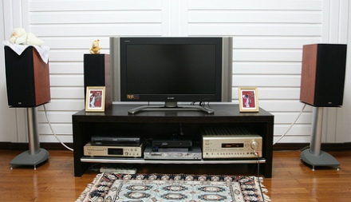
Surge protectors are essential for home office and entertainment centers

Slide 20
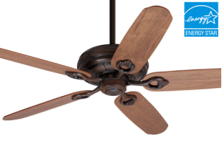
Fans cool people – not rooms!

Slide 21
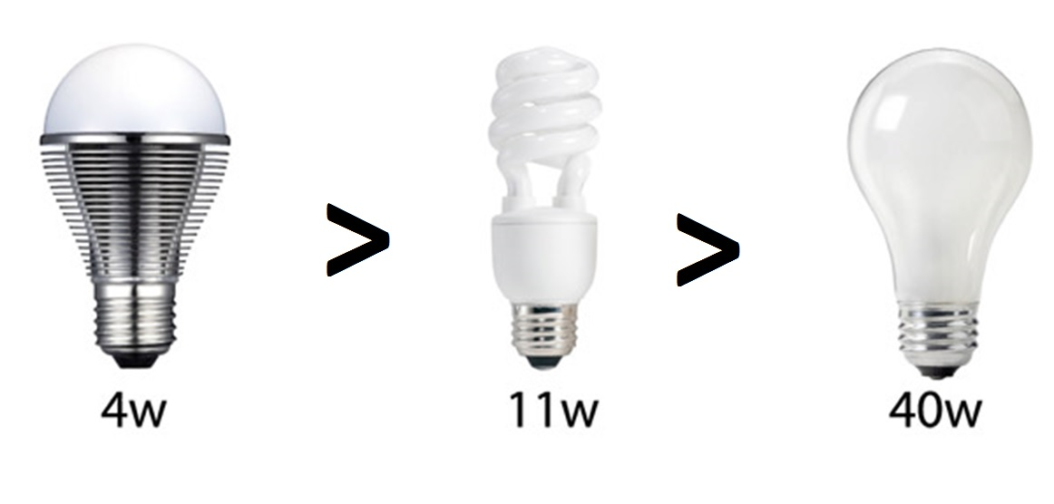
Use energy-efficient lightbulbs
LED CFL INCANDESCENT

Slide 22
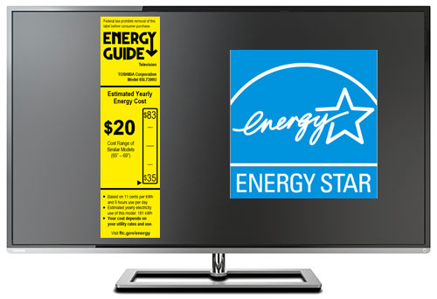

Slide 23

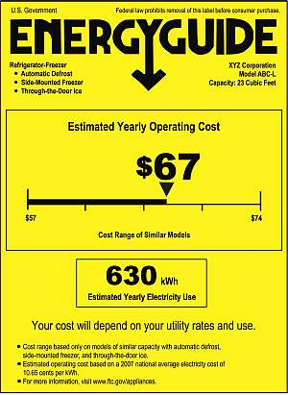
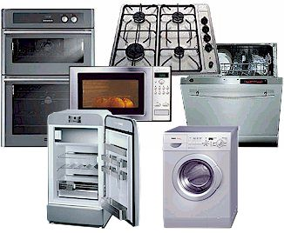
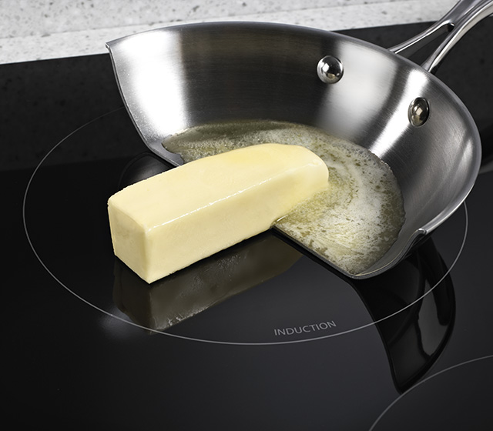

Slide 24
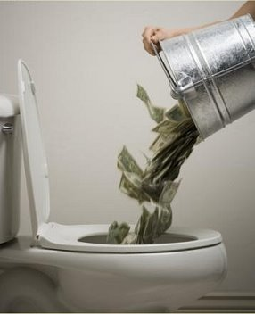
The house itself: where’s the waste?

Slide 25
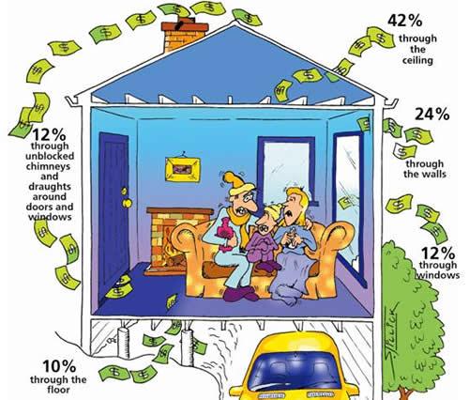
A drafty home is uncomfortable and costly
…and the typical older home today – and many newer ones – have numerous sources of inadequate insulation and weather-stripping.

Slide 26
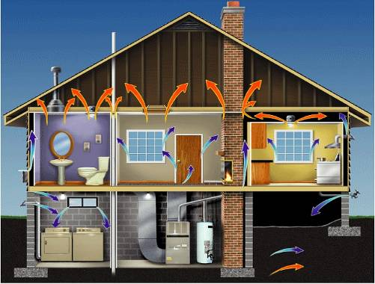
WHY HOMES WORK AND FAIL
WHERE ARE THE BIG HOLES?
Access
Panels
Chases
Dropped
Ceilings
Ceiling fixtures
Sill Plates
Window Openings
Vents
Plumbing Penetrations
Door Openings
Ducts
Top Plates
Notes:
Start with the envelop
Need to understand driving forces
Relatively easy to make upgrades
Attic sealing more important than window weatherstripping

Slide 27
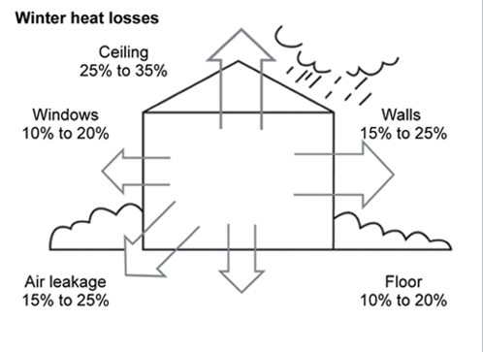
Where to start?
In order of priority…
1. Roof 2. Floor 3. walls & windows

Slide 28
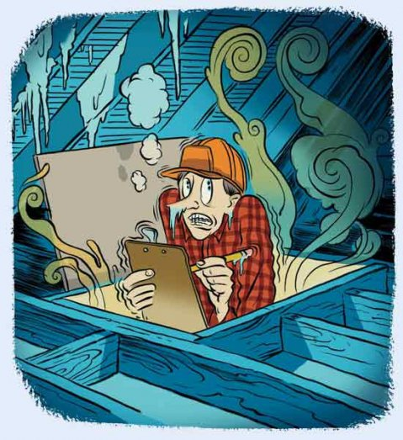
Comfort counts!
Roof insulation makes it possible for you to maintain an ideal inside temperature. You use less energy in the long run.
If you want to use less energy to keep the people and things in your home safe and healthy, insulation is the key.

Slide 29
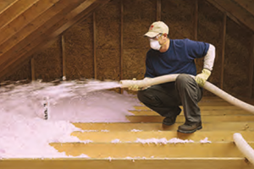
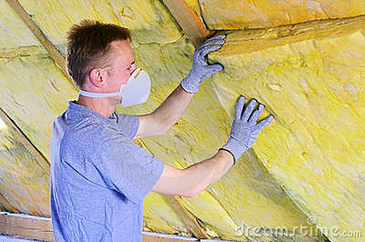
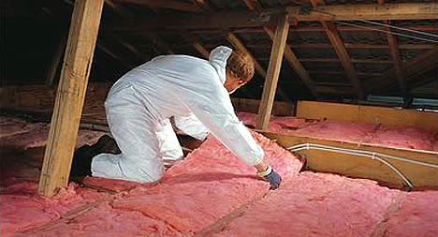
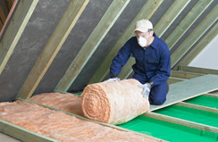

Slide 30
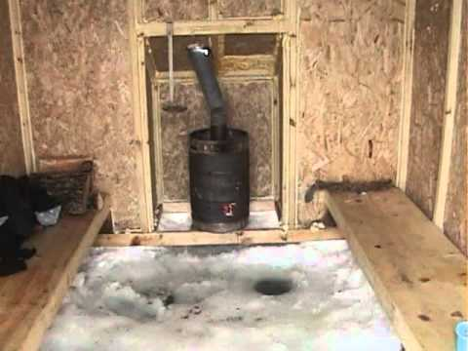

Slide 31
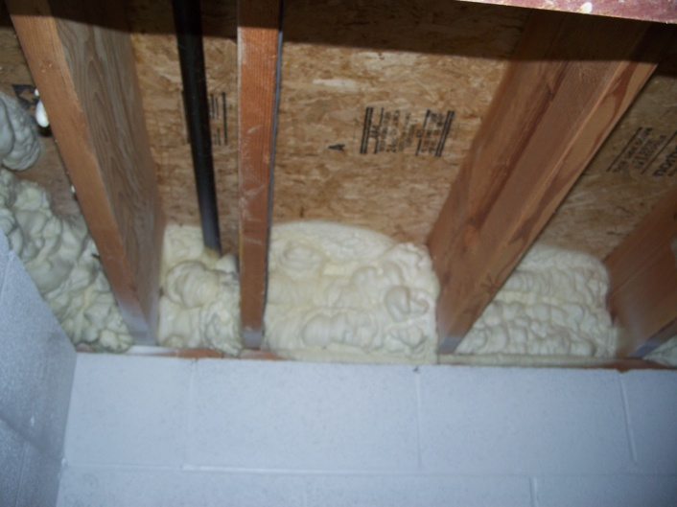

Slide 32
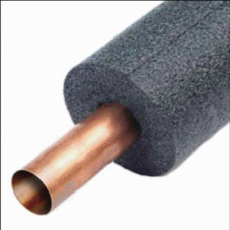
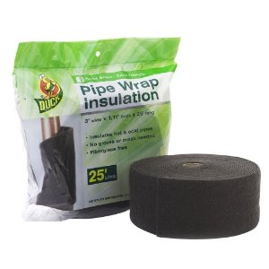

Slide 33
Wrap your water heater!
An inexpensive way to improve energy efficiency and save you money each month. If your water tank is new, it is likely already insulated.
If you have an older hot water tank, check to see if it has insulation with an R-value of at least 24. If not, consider insulating your water tank, which could reduce standby heat losses by 25%–45% and save you about 7%–16% in water heating costs—and should pay for itself in about a year.
You can find pre-cut jackets or blankets available from around $20.

Slide 34
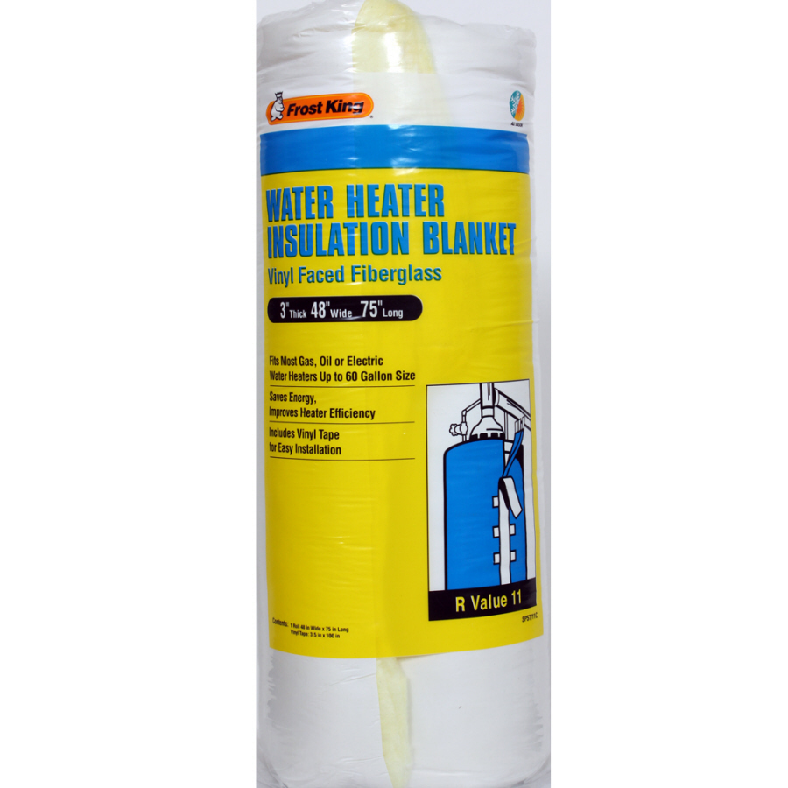

Slide 35


A few thoughts about doors and windows…

Slide 36
Doors and windows…
Are responsible for 10-20% of a home’s heat loss during the cold months
BUT
Are among the easiest energy conservation improvements you can make!

Slide 37
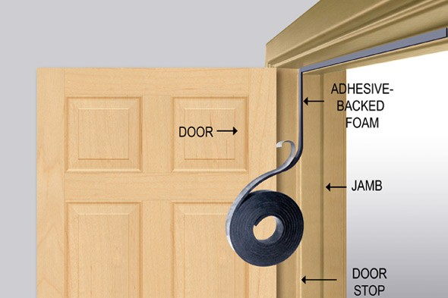

Slide 38
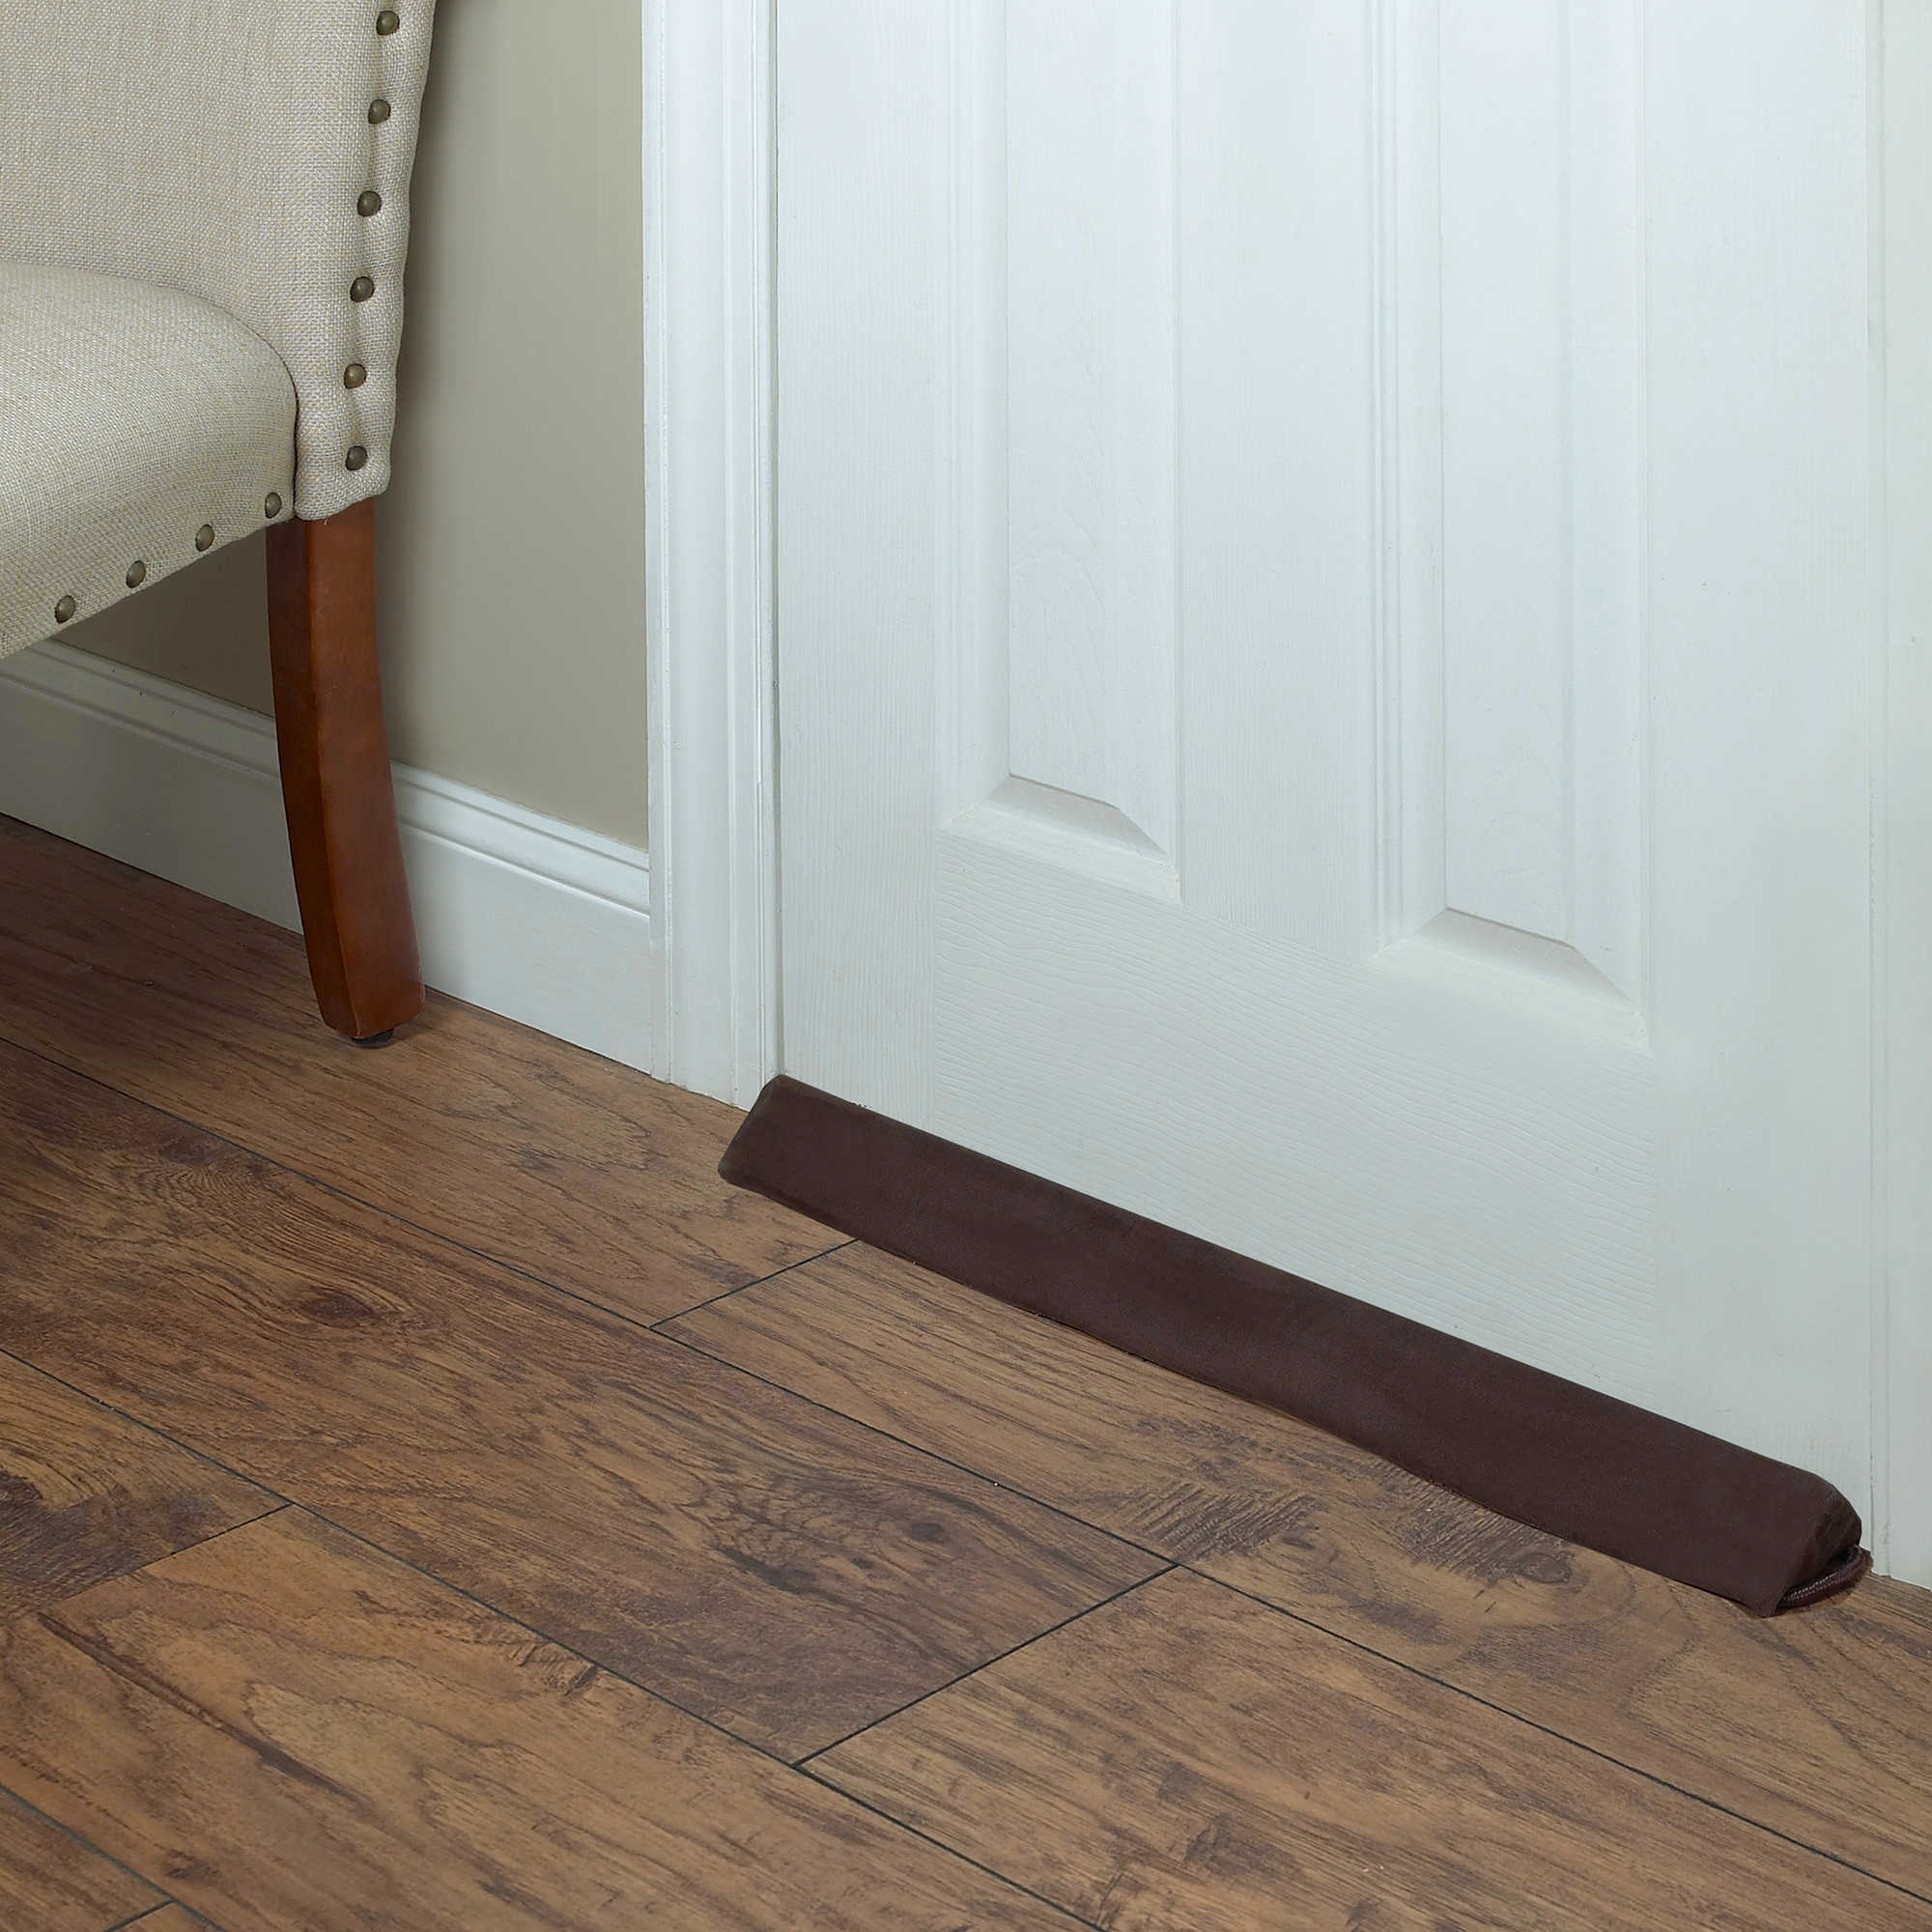

Slide 39
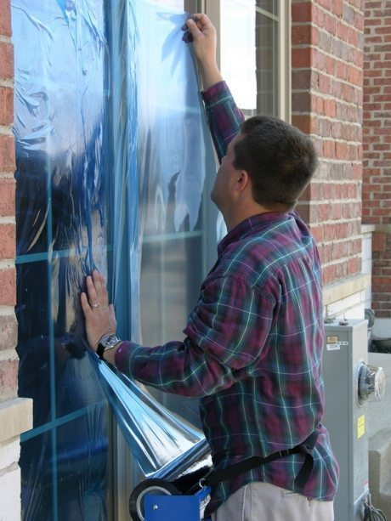

Slide 40
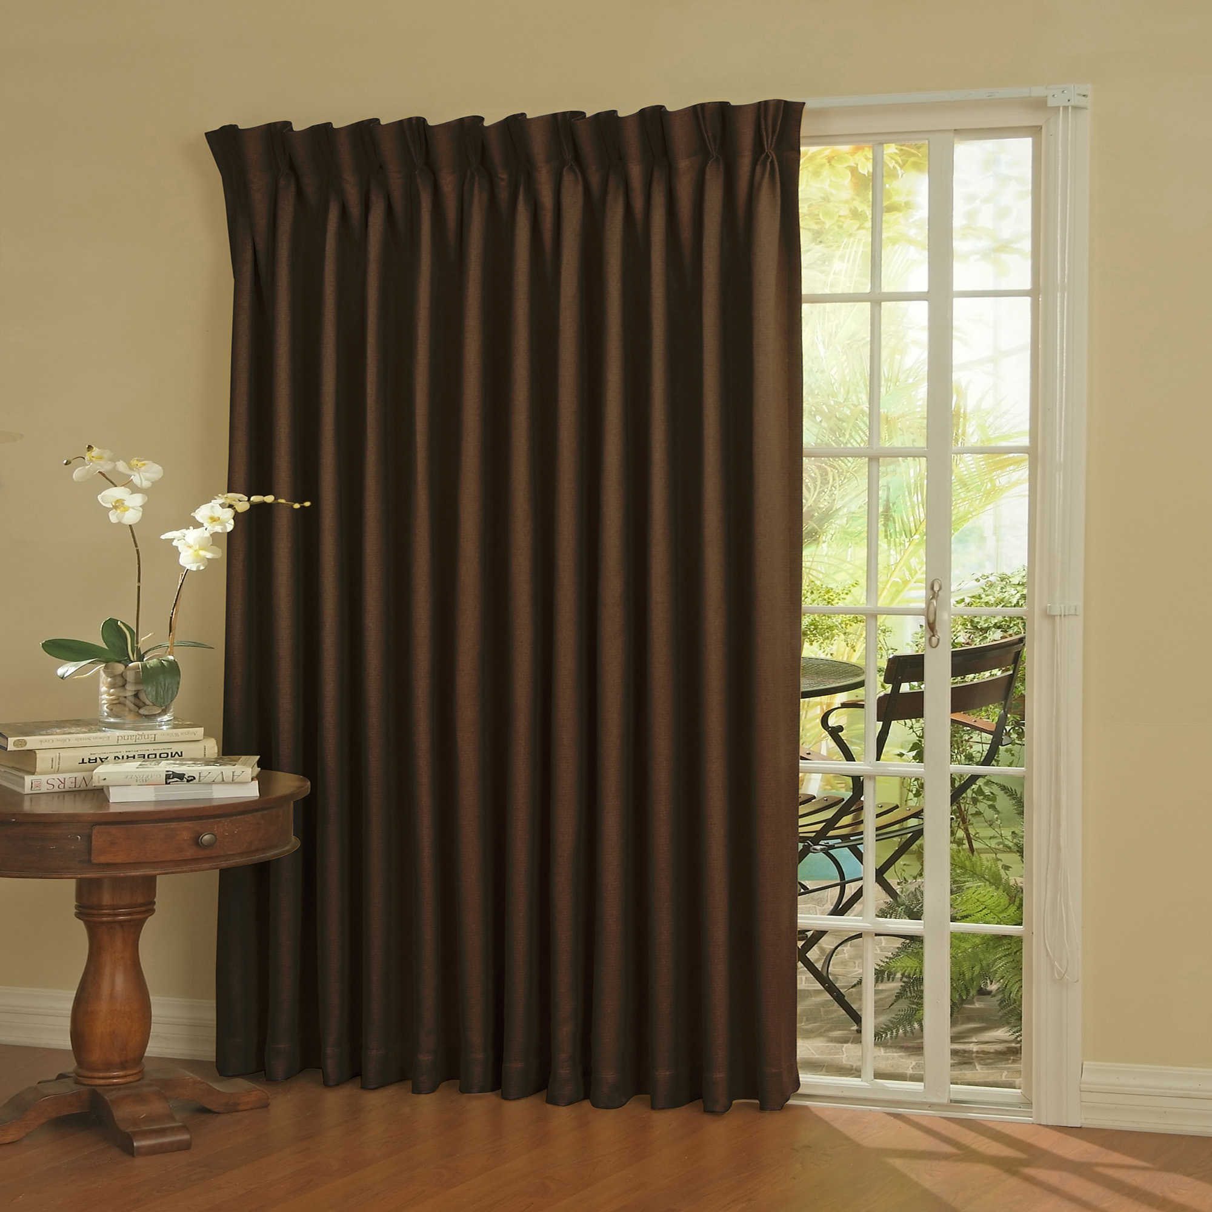

Slide 41

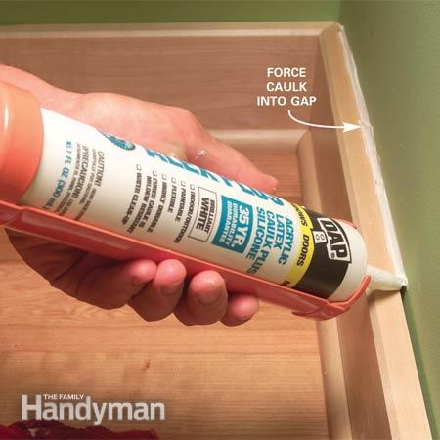
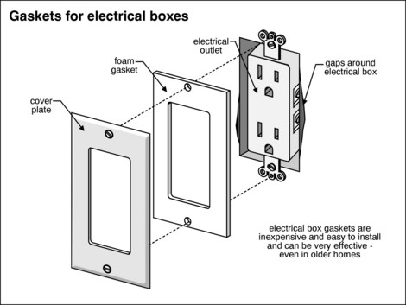
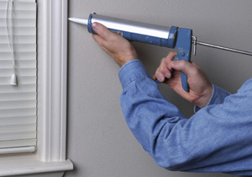

Slide 42
What about alternative energy?

Slide 43
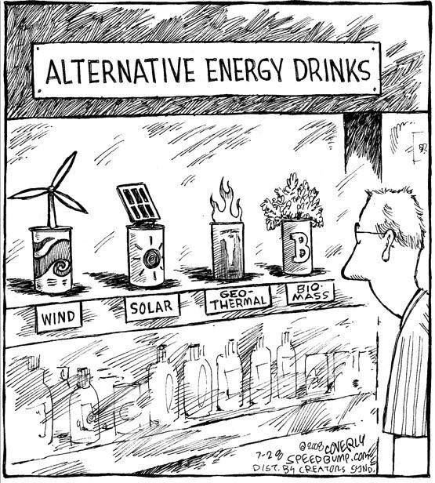

Slide 44
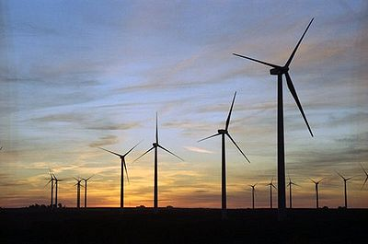
No, alternative as in renewable energy…
Solar
Wind
Geothermal
Bioenergy
Hydropower

Slide 45
U.S. Renewable Energy Growth Accelerates
Wind, solar, and geothermal energy are all on the rise. At least 17,000 megawatts (MW) of these three energy sources are now under construction. According to the Energy Information Administration, renewable energy will account for about one-third of new electricity generation added to the U.S. grid over the next three years.
Worldwatch Institute, Feb. 7, 2017

Slide 46
Solar Employs More People In U.S. Electricity Generation Than Oil, Coal And Gas Combined
According to a new report from the U.S. Department of Energy, solar power employed 43 percent of the Electric Power Generation sector's workforce in 2016, while fossil fuels combined accounted for just 22 percent.
-- Forbes, Jan. 25, 2017

Slide 47
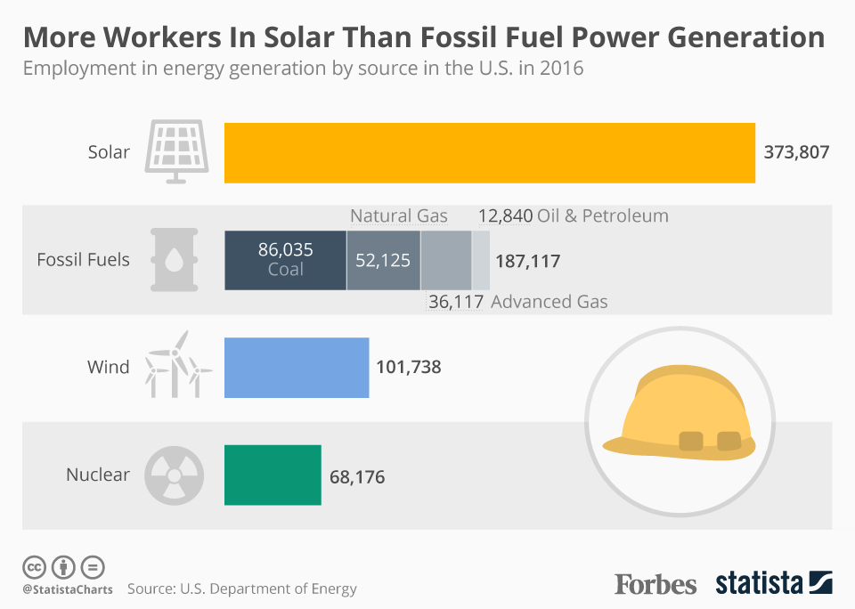

Slide 48
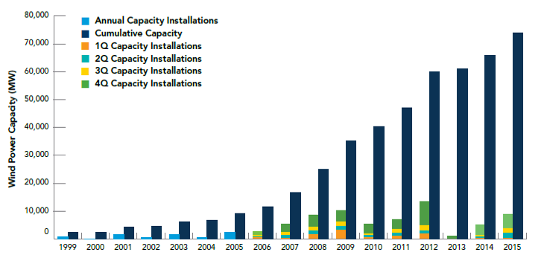
Wind Energy
Total U.S. installed wind capacity, through end of 2015: 73,992MW -- American Wind Energy Association

Slide 49

True facts
Solar energy works in Michigan
Wind does, too
A huge problem has been storage for use when needed
But it looks like even that problem may be solved soon…

Slide 50
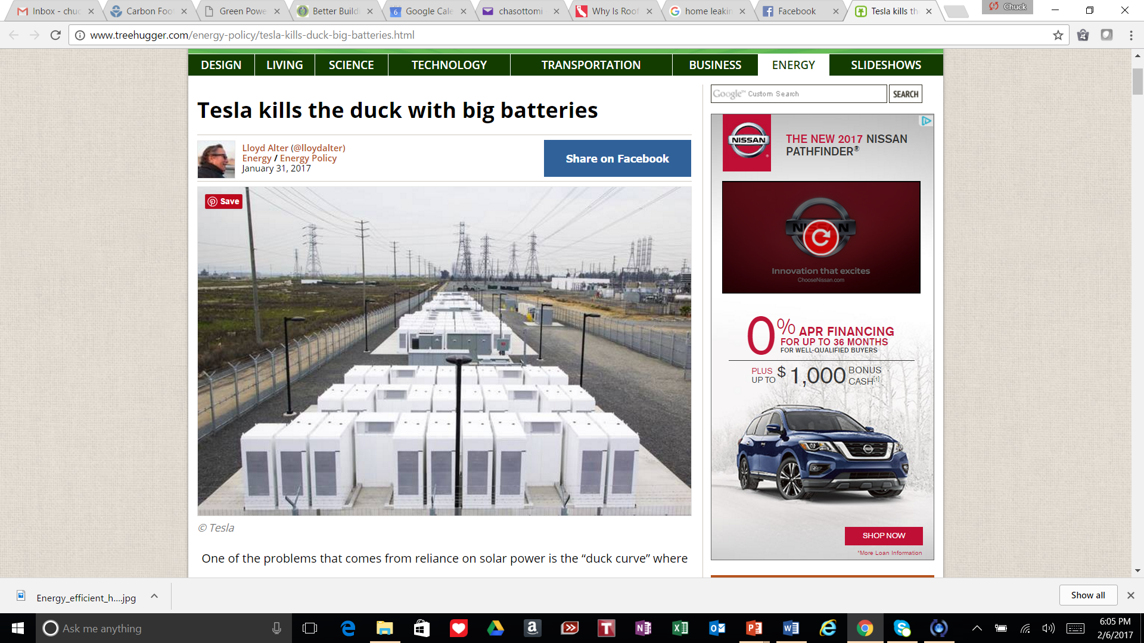

Slide 51
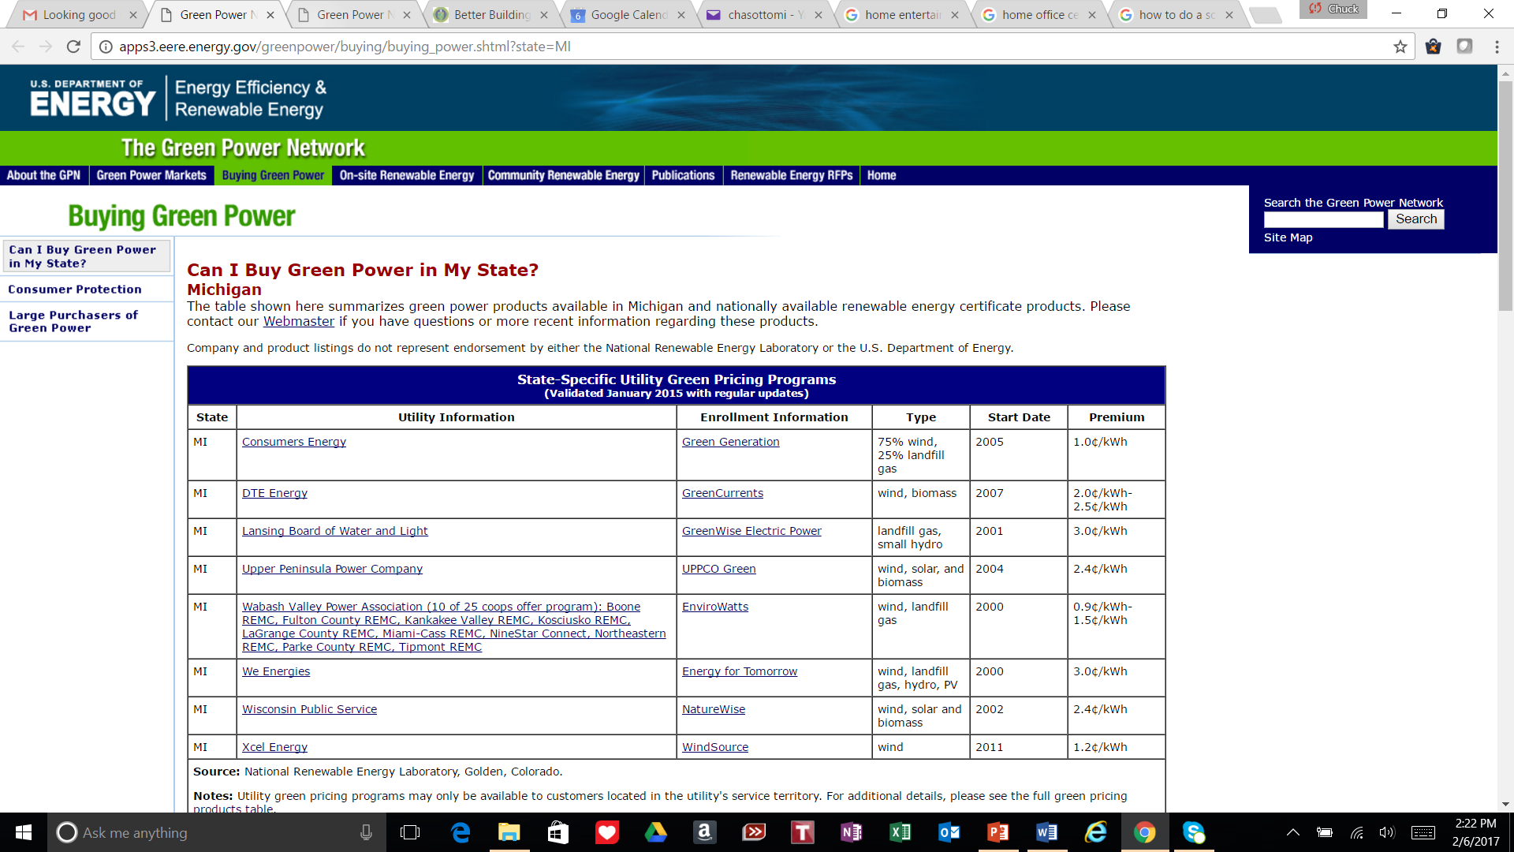

Slide 52


Slide 53
Special Thanks
Brett Little
616.458.6733
Brett.Little@greenhomeinsitute.org

Slide 54


Slide 55
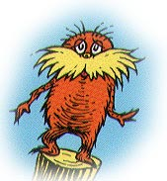
Thank You!
Chuck Otto
Corporate Sustainability Communications
chuck.otto1@gmail.com

