Slide 1
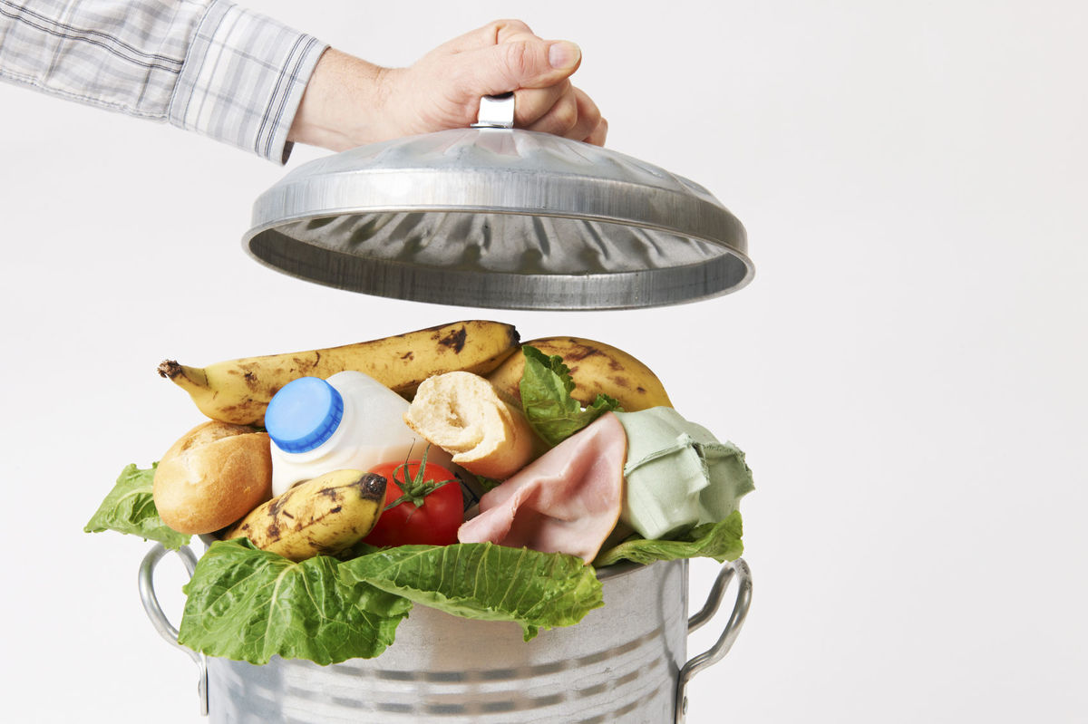
Food waste: What’s the big deal?

Slide 2
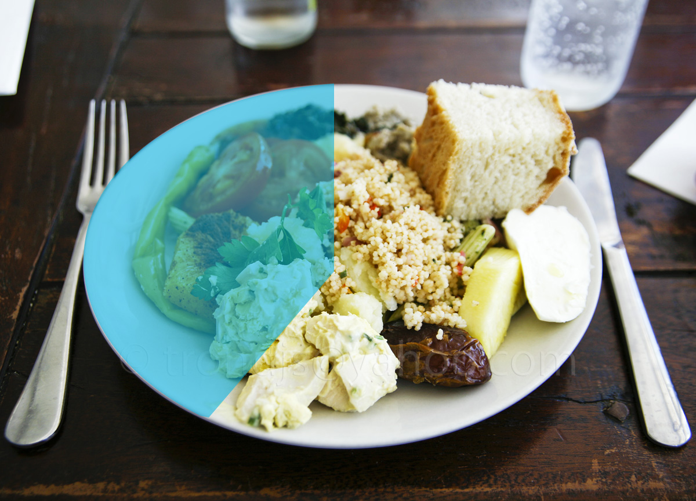
40%
of all food
goes uneaten
Image Source: trijandjs

Slide 3
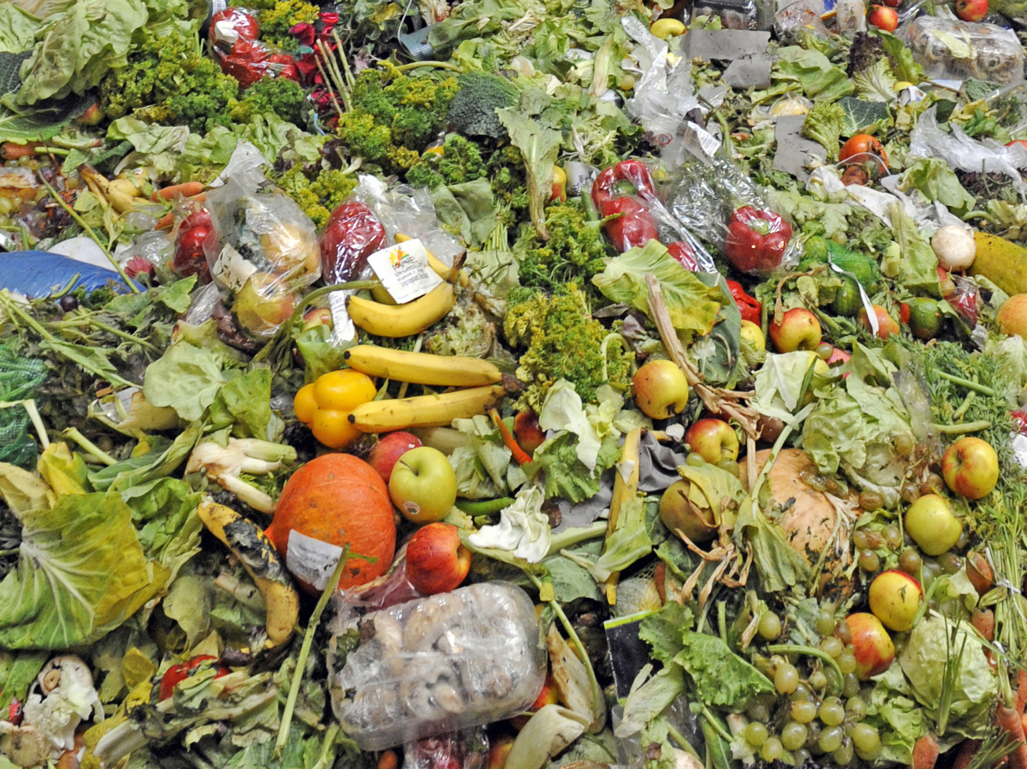
$218 billion
Is the value of what we waste every year in America.
Notes:
Citations
141 trillion calories gone to waste: Buzby, Jean C., Hodan F. Wells, and Jeffrey Hyman. The Estimated Amount, Value, and Calories of Postharvest Food Losses at the Retail and Consumer Levels in the United States, EIB-121, U.S. Department of Agriculture, Economic Research Service, February 2014. Available at http://www.ers.usda.gov/media/1282296/eib121.pdf.
$218 Billion production costs: ReFED. 2016. A Roadmap to Reduce U.S. Food Waste by 20 Percent. Available at: http://www.refed.com/download, p. 10
$1500 annual cost per family of four - Bloom, Jonathan. American Wasteland (2010), p. 187

Slide 4

Where does food waste occur?
- Consumers are largest source
Grocery,
Restaurants, Foodservice
Consumers
43%
Producers
40%
16%
Processors
2%
Notes:
Citations
All statistics: ReFED. 2016. A Roadmap to Reduce U.S. Food Waste by 20 Percent. Available at: http://www.refed.com/download,
p. 13
Recycling percentages:
Processors: 93% of their food excesses are recycled
Retail: 13% of their surplus is donated, 29% of it is recycled
Restaurants: Only 1.4% of their surplus food is donated, 14% is recycled
BSR, 2014. Analysis of U.S. Food Waste Among Food Manufacturers, Retailers, and Restaurants. Report prepared for the Food Waste Reduction Alliance, available at: http://www.foodwastealliance.org/wp-content/uploads/2014/11/FWRA_BSR_Tier3_FINAL.pdf

Slide 5
Consumer Waste
The Life and Times of Strawberry

Slide 6







What gets wasted?
Milk
2%
Meat
Grains
Seafood
Fruits and Vegetables
Notes:
Note challenges in availability of comprehensive food waste data.
Producers 7%
Processors 1%
Grocery (10%), Restaurants (30%), FS 10%
Consumers 42%
Processors: 93% of their food excesses are recyled
Retail: 13% of their surplus is donated, 29% of it is recyled
Restaurants: Only 1.4% of their surplus food is donated, 14.3% is recycled

Slide 7

The Collateral Damage of Wasting Food
Everything that goes into producing food is also wasted.

Slide 8
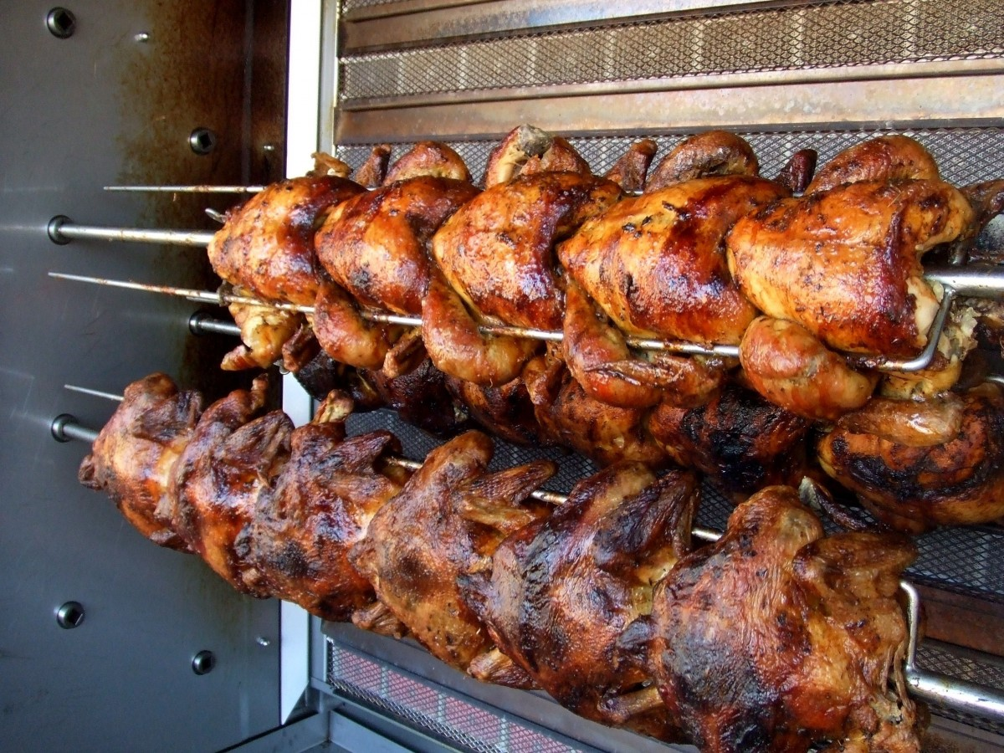

Slide 9
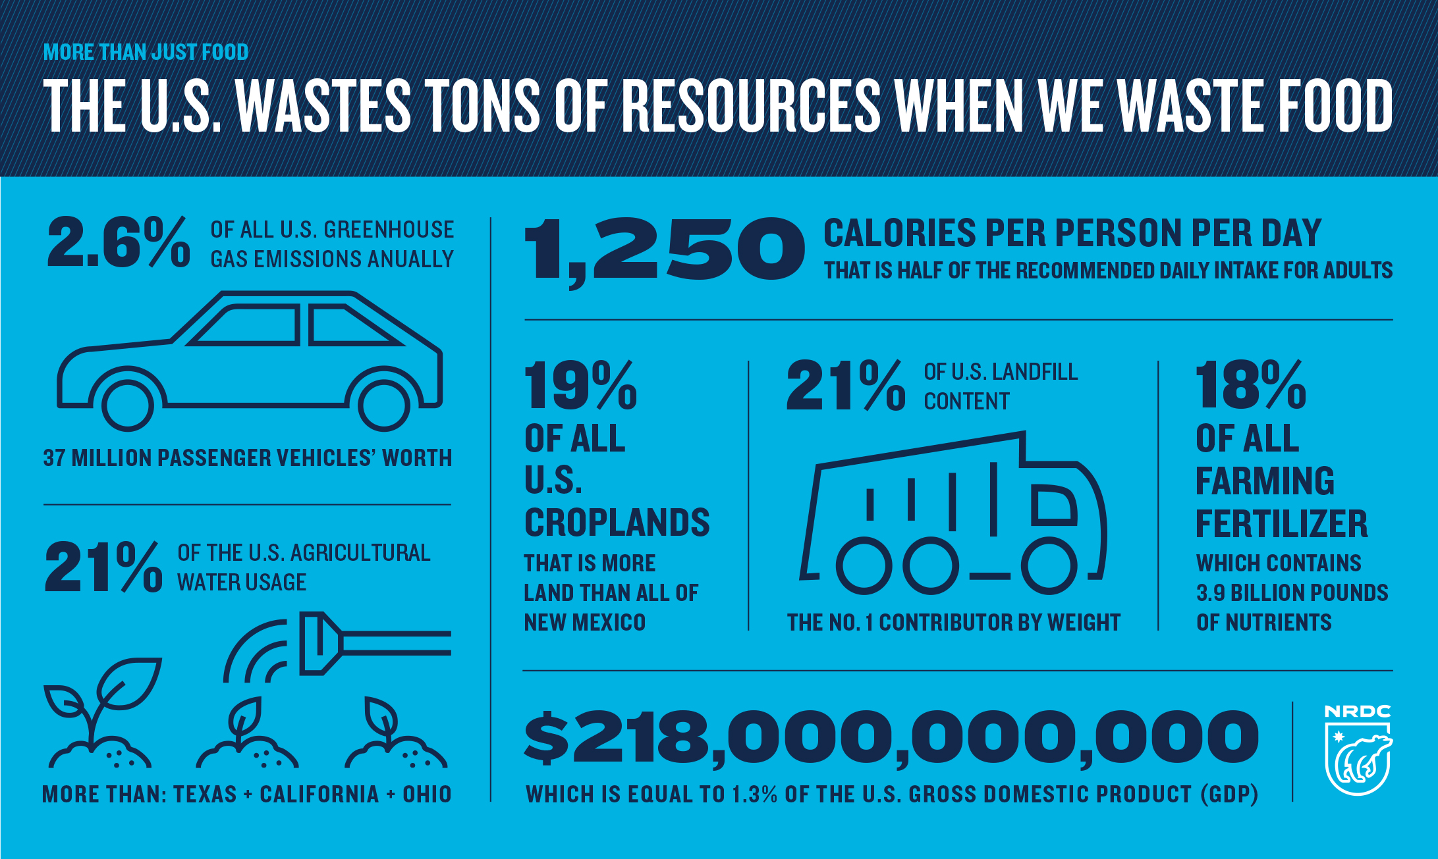

Slide 10
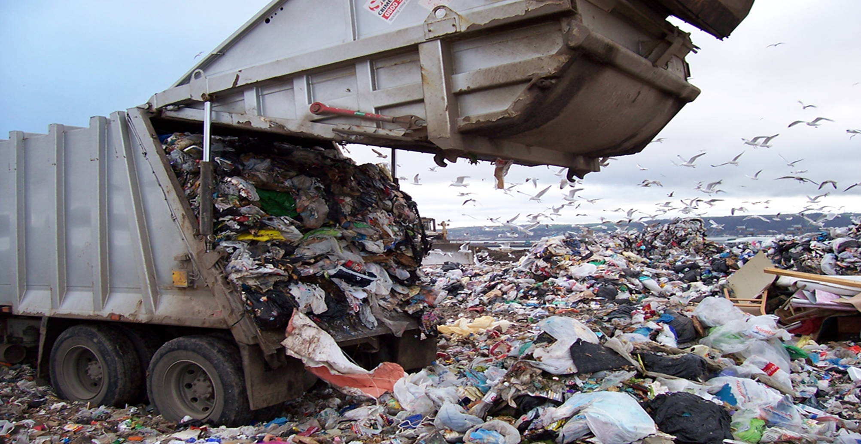
95%
of food waste goes to
landfills or incinerators
21%
of landfill content is food
Advancing Sustainable Materials Management, 2013 Fact Sheet (EPA)
Notes:
Citations:
95% of food waste to landfill: Advancing Sustainable Materials Management: Assessing Trends in Material Generation, Recycling and Disposal in the United State. 2013 Fact Sheet (EPA). 2015. Available at: http://www2.epa.gov/sites/production/files/2015-09/documents/2013_advncng_smm_fs.pdf.
21% of landfill contents: US EPA. Advancing Sustainable Materials Management: Assessing Trends in Material Generation, Recycling and Disposal in the United State. 2013 Facts and Figures. 2015. Available at: http://www3.epa.gov/epawaste/nonhaz/municipal/pubs/2013_advncng_smm_rpt.pdf.

Slide 11
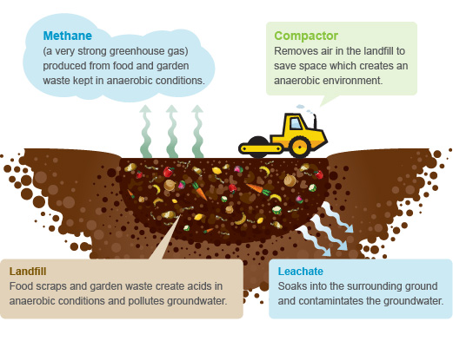

Slide 12

If food waste globally were a country, it would be the third largest emitter of GHG in the world after China and the US.

Slide 13
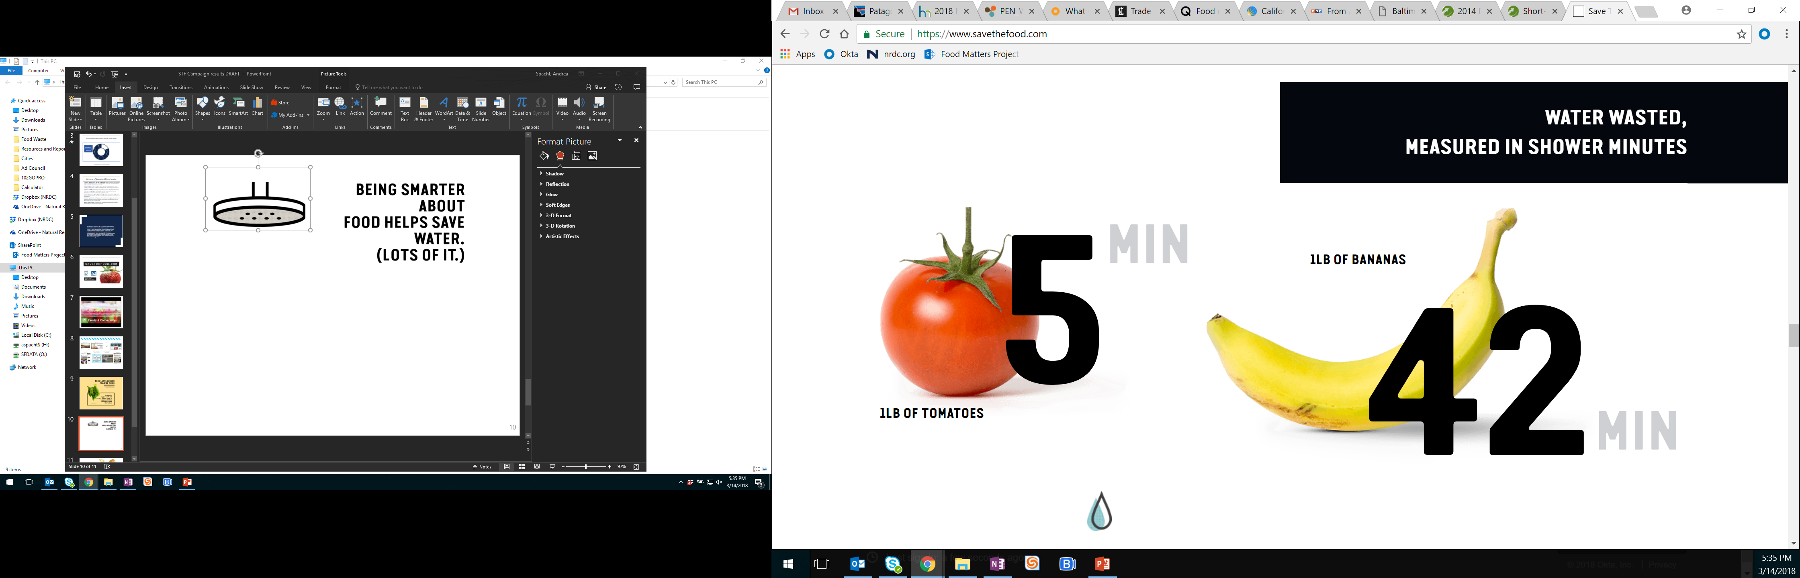
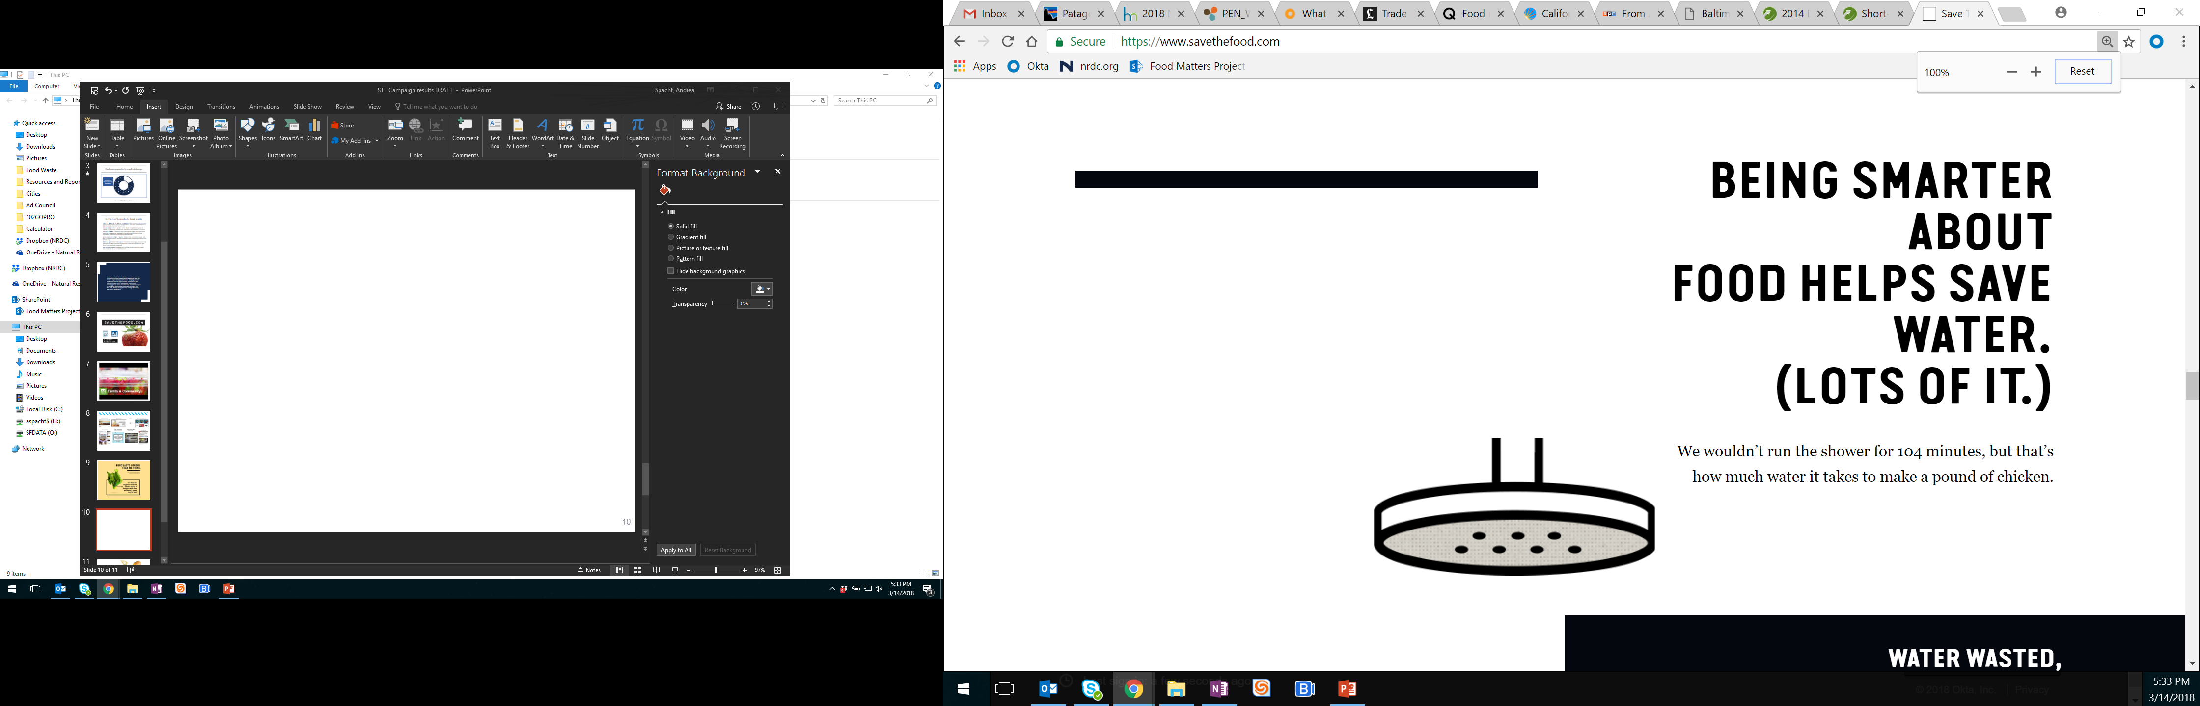
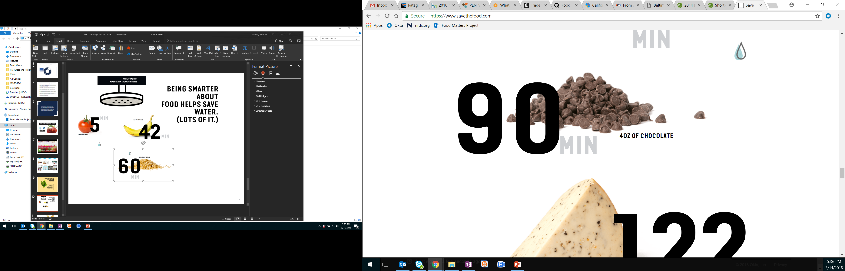
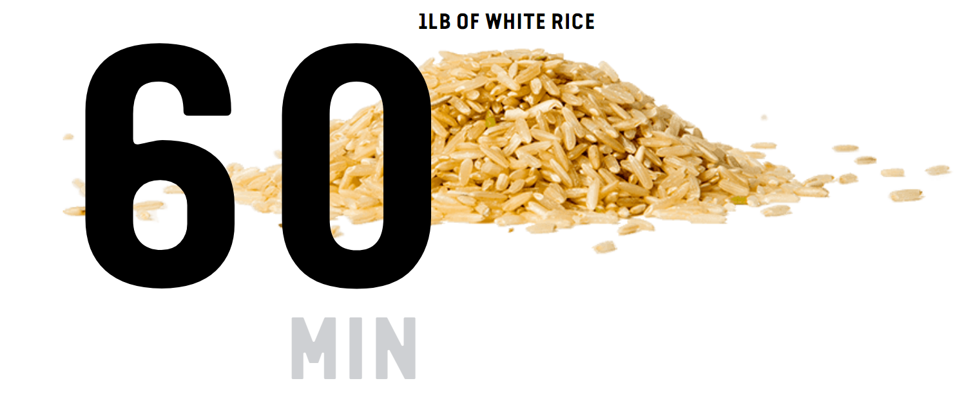
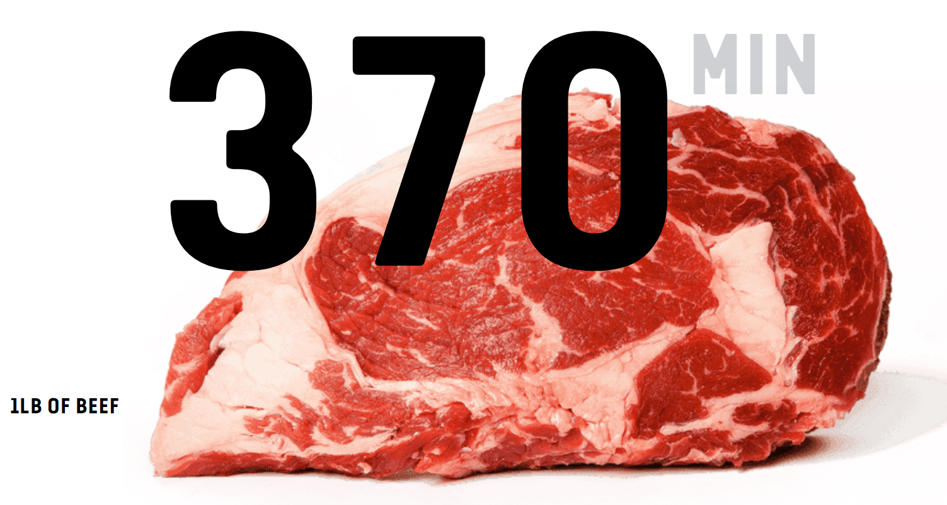
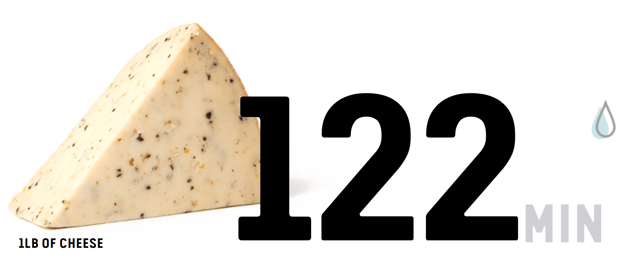

Slide 14

Notes:
Citations
Reduce losses by 30%, feed 50 million Americans: K.D. Hall, J. Guo, M. Dore, C.C. Chow, National Institute of Diabetes and Digestive and Kidney Diseases, “The Progressive Increase of Food Waste in America and Its Environmental Impact,” PLoS ONE 4(11):e7940, 2009.
One in seven Americans is food insecure, including 110,000 adults and children in Davidson County alone: Feeding America, Map the Meal Gap 2014 , available at http://map.feedingamerica.org/county/2014/overall/tennessee/county/davidson

Slide 15

New
National Goal
Reduce
food waste by
50%
by 2030
Notes:
Citations
50% by 2030 goal: U.S. Dept. of Agriculture. (2015, Sept 16). USDA and EPA join with private sector, charitable organizations to set nation’s first food waste reduction goals. Press release. Available at: http://www.usda.gov/wps/portal/usda/usdahome?contentid=2015/09/0257.xml&navid=NEWS_RELEASE&navtype=RT&parentnav=LATEST_RELEASES&edeployment_action=retrievecontent

Slide 16

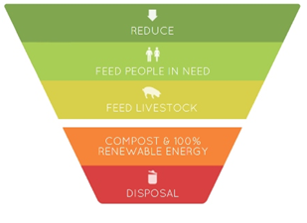
Prioritizing Action
Least Preferred

Slide 17

Biggest Environmental and
Financial Bang for the Buck:
Consumer education
Standardized date labelling
Waste tracking & analytics
Tax incentives for food donation

Slide 18
Drivers of household food waste
LACK OF AWARENESS AND INFORMATION: Many consumers are not aware of how much food they waste or its implications. Some also lack information or skills to properly store and “use up” food.
POOR STORAGE: Food spoils in homes due to suboptimal storage, poor visibility in refrigerators, partially used ingredients, and misjudged food needs.
POOR PLANNING: Consumers may overbuy because they fail to plan meals, fail to use a shopping list, inaccurately estimate what is needed for meal preparation, or decide on impromptu restaurant meals.
CONFUSION OVER DATE LABELS: Multiple dates, inconsistent usage, and lack of education around date label meanings cause consumers to discard food prematurely.
IMPULSE AND BULK PURCHASES: Promotions encouraging unusual or bulk purchases result in consumers buying foods outside their typical needs, and these foods may not be consumed.
OVERPRODUCTION: Preparing more food than needed can lead to waste unless leftovers are saved and consumed.

Slide 19
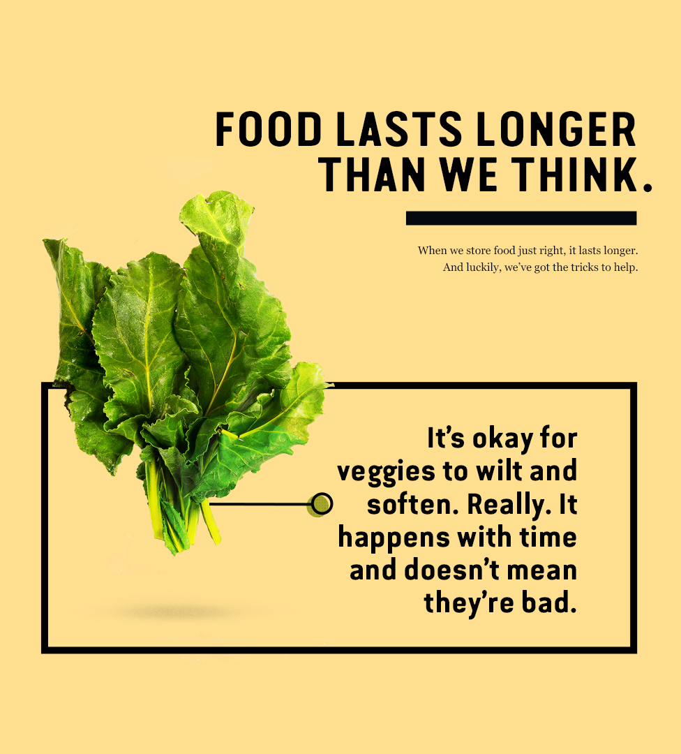

Slide 20

What You Can Do
Plan meals ahead
Store your food smartly
Eat leftovers
Freeze what you can’t eat
Understand expiration dates
Use your nose and common sense
Pass along large scale leftovers

Slide 21


Buy less food
Have a “use me first” bin in your fridge
Start a compost pile or add to a neighbor’s
Buy seconds when you can
Speak up at grocery stores
Use your freezer a lot

Slide 22
Resources
Savethefood.org
Just Eat it Film-Sponsor a showing
Host a book group
Host a dinner at your home featuring FW
Volunteer
Advocate
Understand the Law

Slide 23
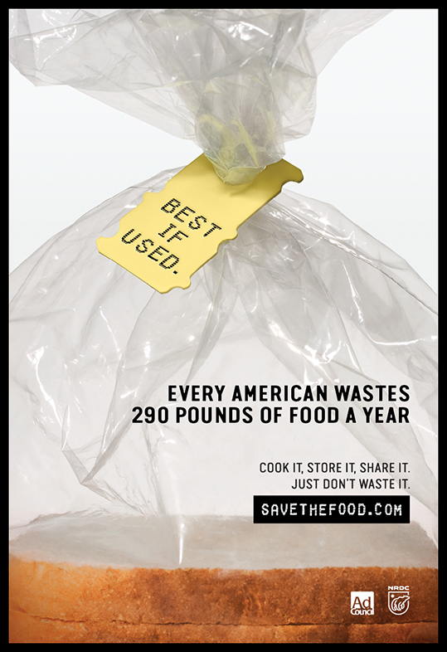
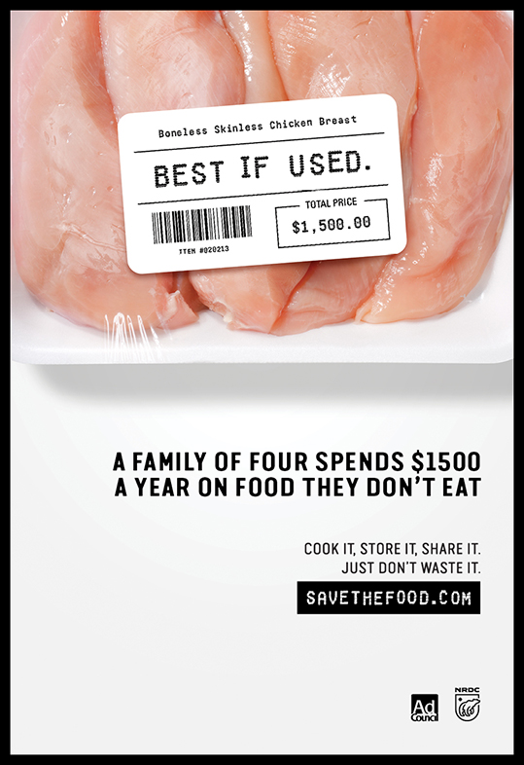
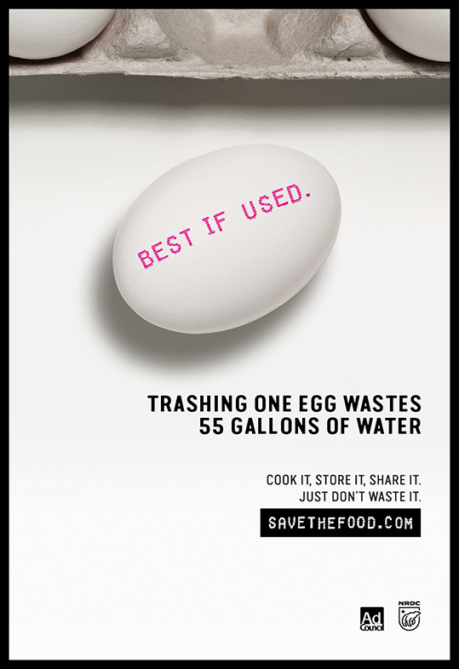
Cook it, store it, share it. Just don’t waste it.
Notes:
We have these available to include in print media (including newspapers, magazine) and available as posters to print and hang in grocery stores, restaurants, schools and other public buildings

Slide 24
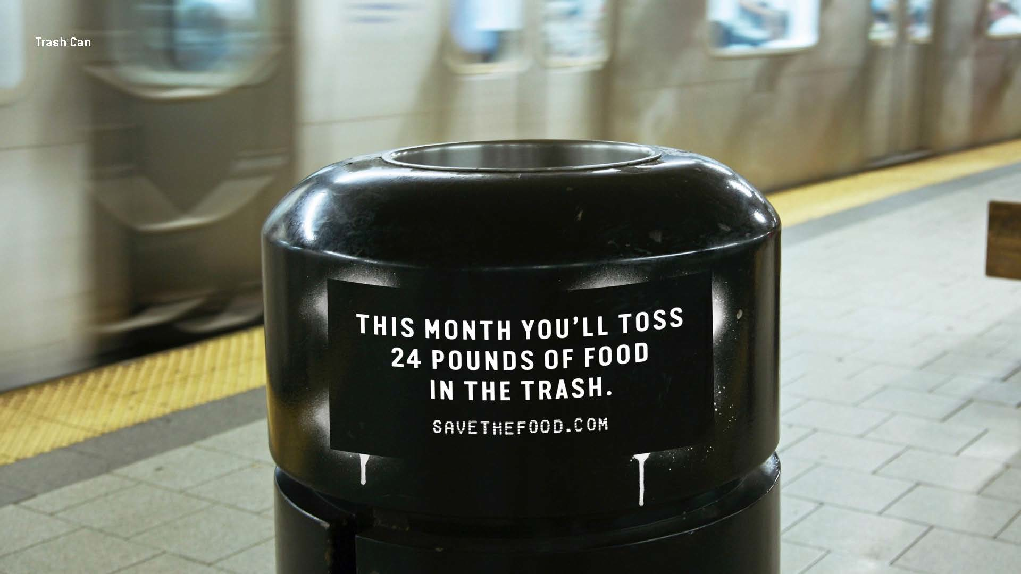
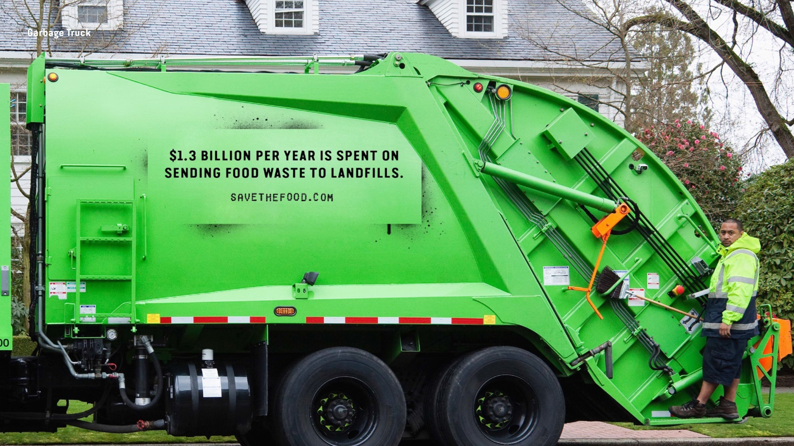
TRASH FACTS: GUERRILLA TACTICS
Notes:
- Here is an example of the trash bin, which you can put on your public trashcans

