Slide 1
Growing is Giving
The art and science of planting, growing and harvesting with purpose, passion and a commitment to bettering ourselves and the world we serve.

Slide 2
“To own a bit of ground, to scratch it with a hoe, to plant seeds, and watch their renewal of life – this is the commonest delight of the race, the most satisfactory thing a man can do.”
Charles Dudley Warner, American Essayist, novelist and friend of Mark Twain. 1829 - 1900
My Journey Into Gardening
From weeding to seeding
Texas trials – Learning to balance the sun between sun and water
The beauty of Raised Beds – maximizing yield for maximum enjoyment!

Slide 3
Three ways to create a simple garden
Garden on the ground | Garden in pots | Raised Beds
As big as you want given the space you have | Perfect for smaller space or no yard | Add more beds as you grow more….or don’t!
Weeds love this approach | No weeds, easy to water and maintain | Keep weeds at bay
Soil quality may be questionable or need help | Soil of your choice | Soil of your choice
Critter buffet | Easy to protect from critters and the elements | Easy to fence and protect
Potential for high yield but labor intensive | Low but predictable yield | High yield per square foot

Slide 4
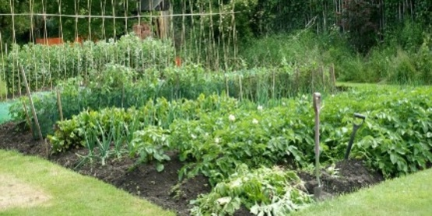
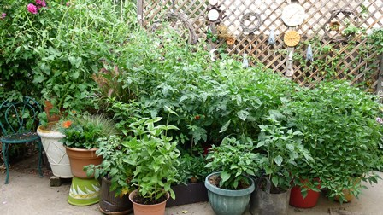
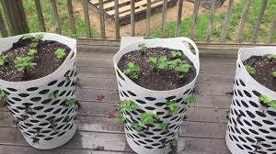
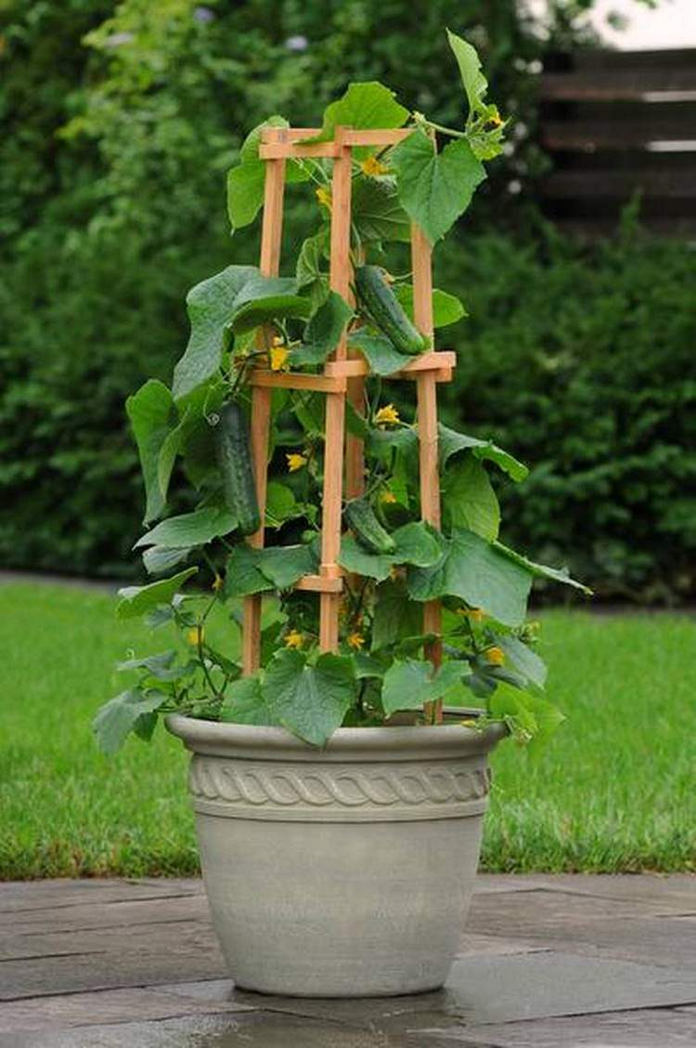
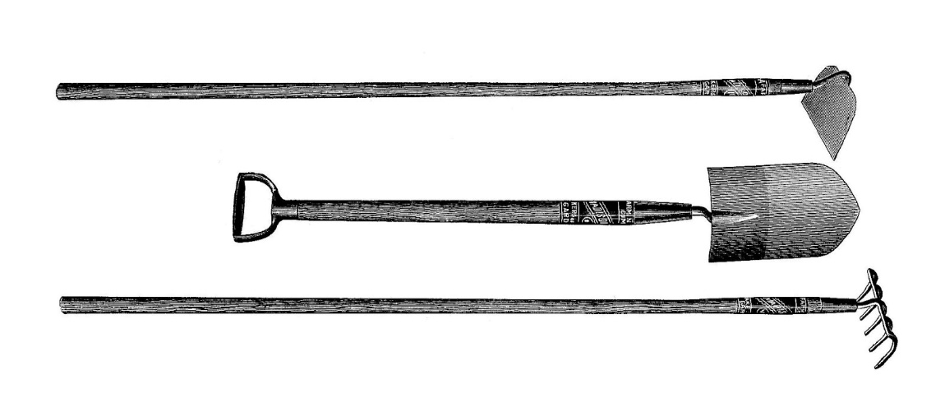
Gardening on the ground
Growing in small pots

Slide 5
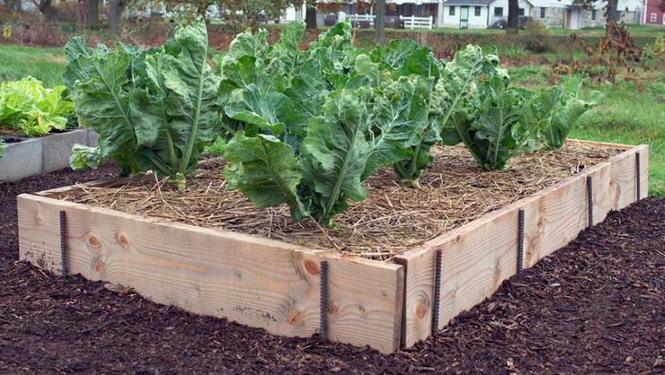
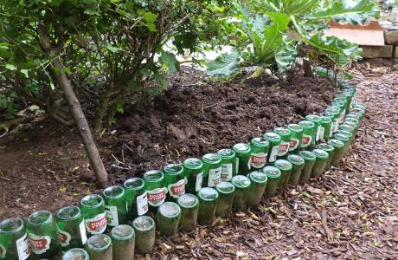
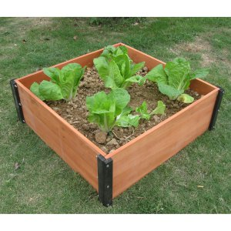
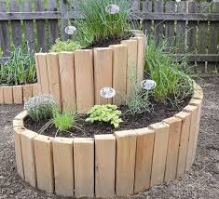
Raising awareness for Raised Beds!

Slide 6
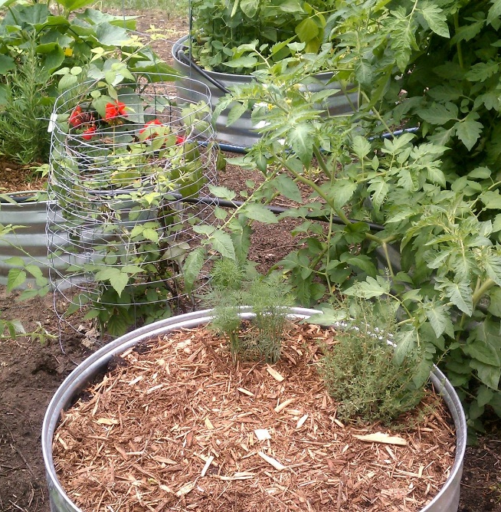
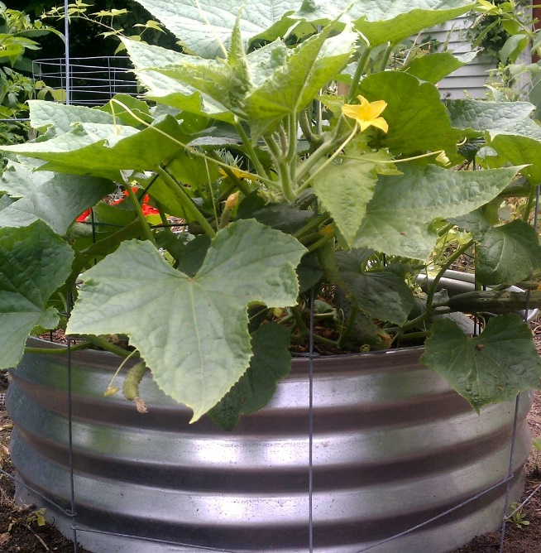
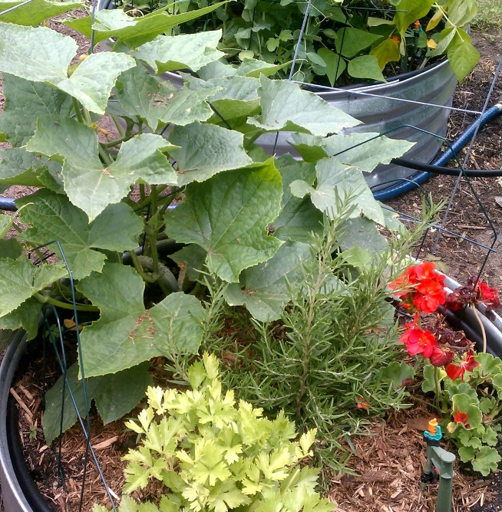
What is 12” high, fairly inexpensive, impervious to water, and can become a garden in a day?
4 Steel Fire Pits
Filled with 50/50 dirt and compost/manure
Plant with cukes, zucchini, eggplant, peppers, herbs ……

Slide 7
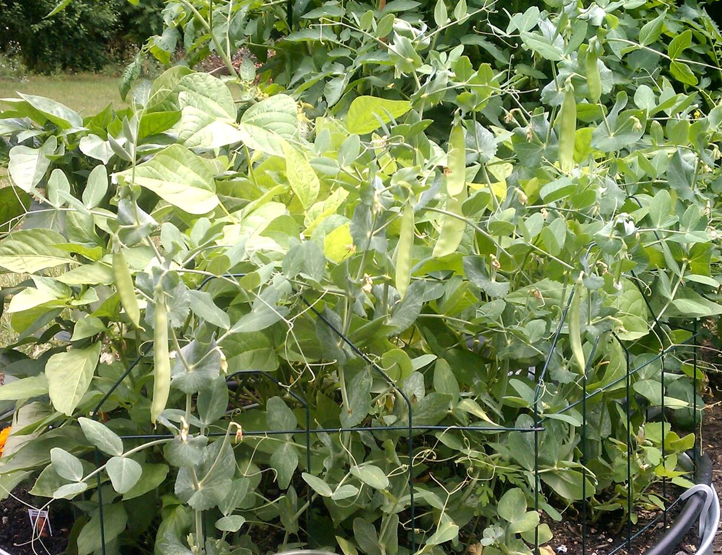
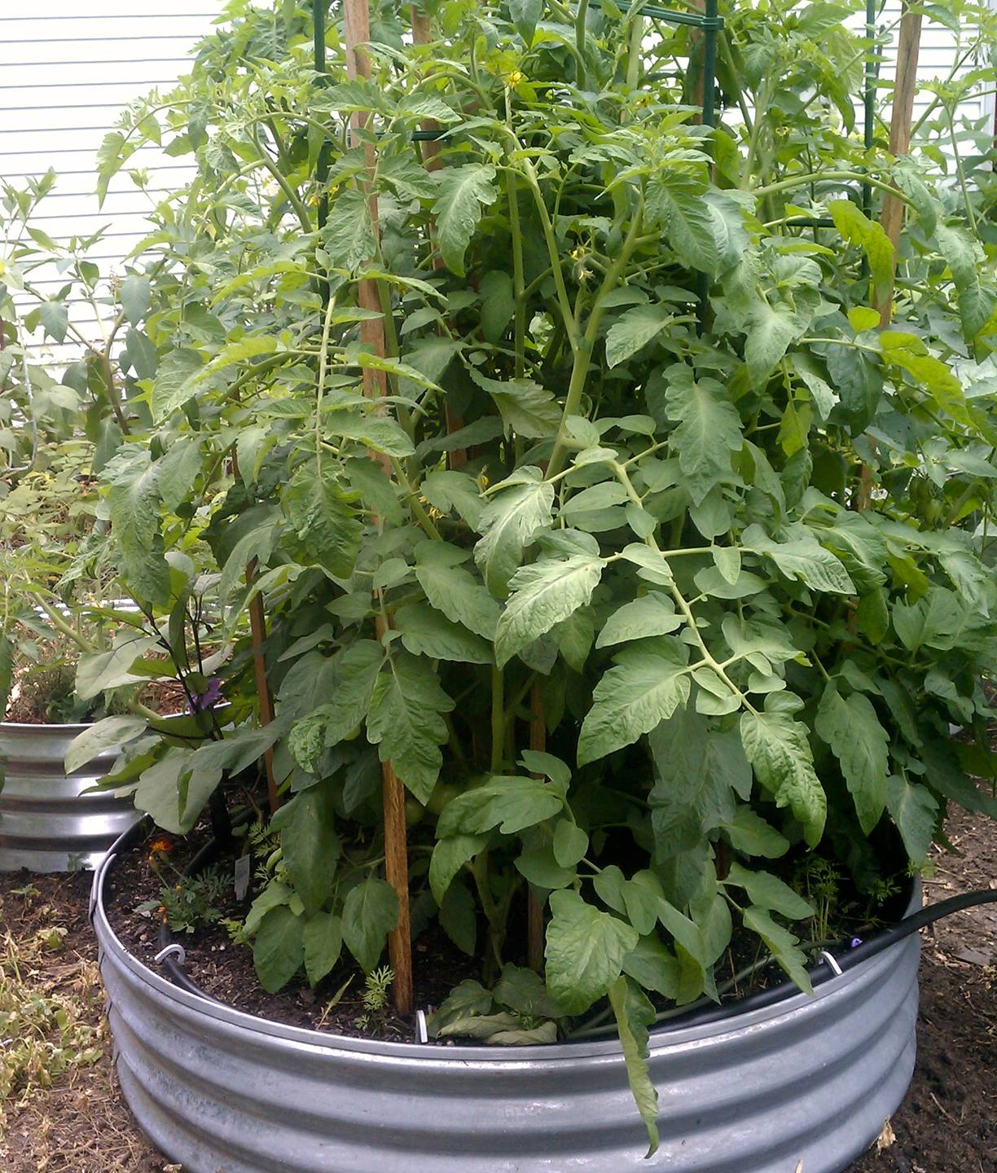
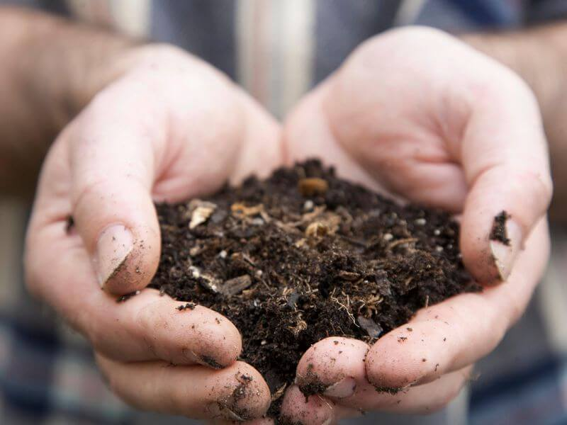
“The love of the dirt is among the earliest passions, as it is the latest. Mud-pies gratify one of our first and best instincts. So long as we are dirty we are pure.”
Charles Dudley Warner

Slide 8
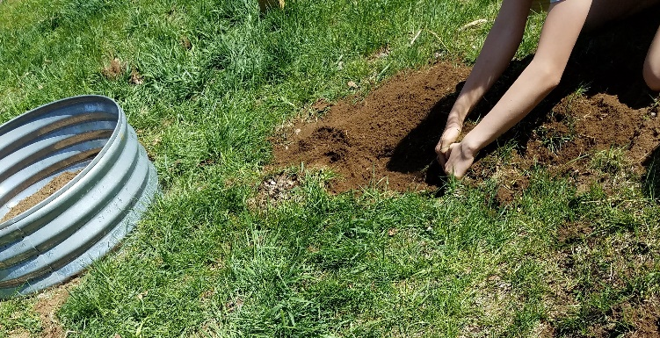
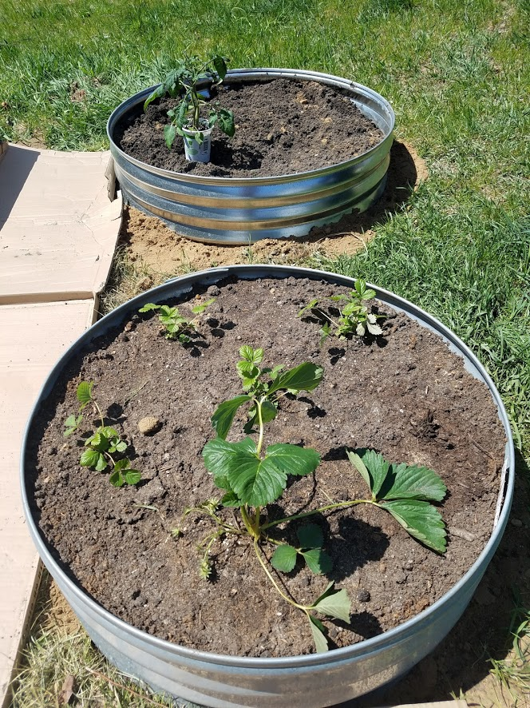
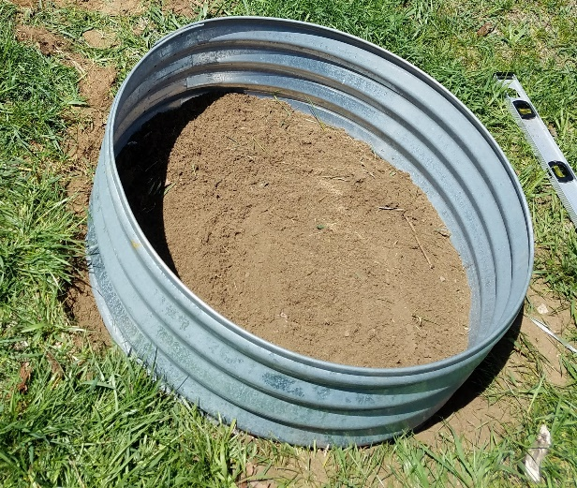
2 Simple and not so elegant or expensive options to creating your own raised beds…

Slide 9
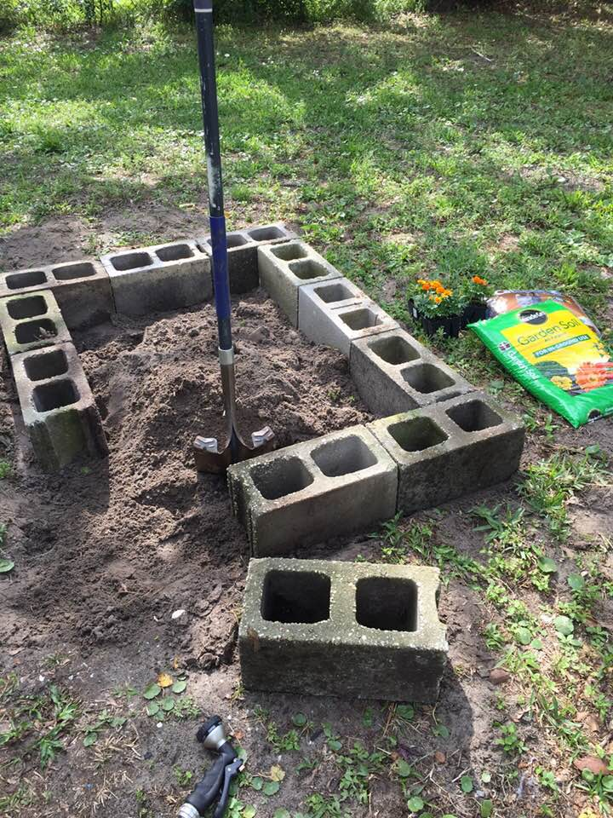
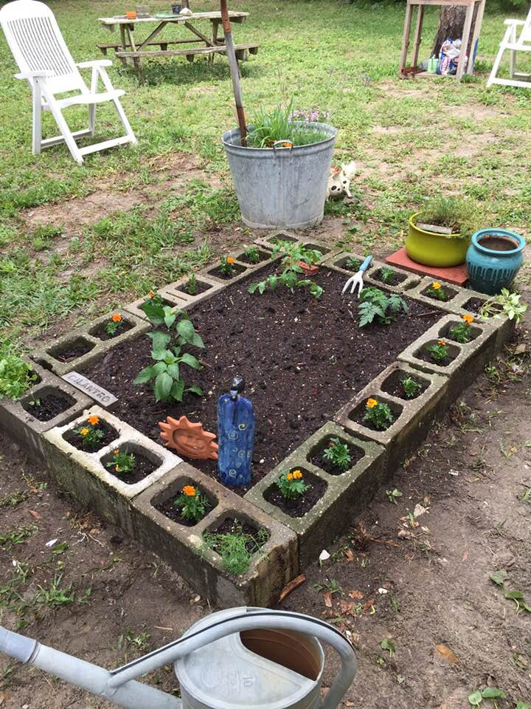
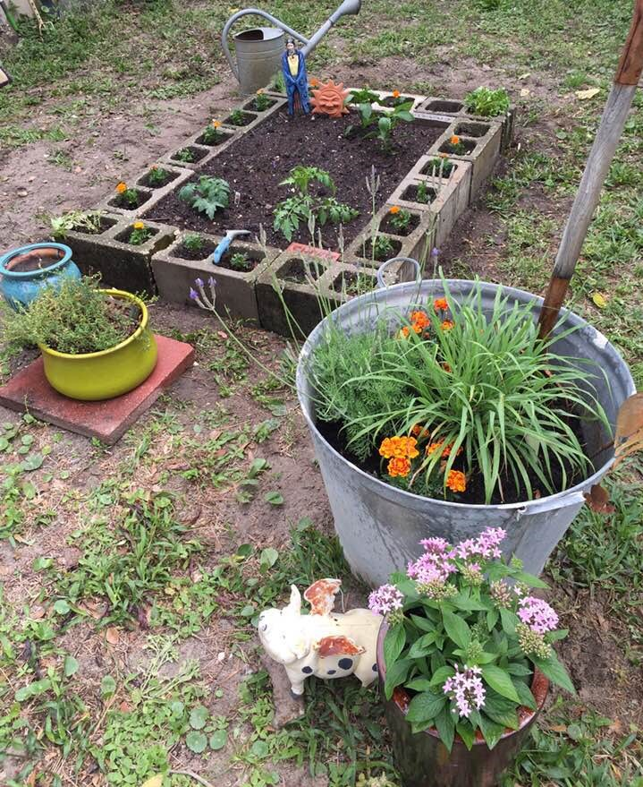

Slide 10
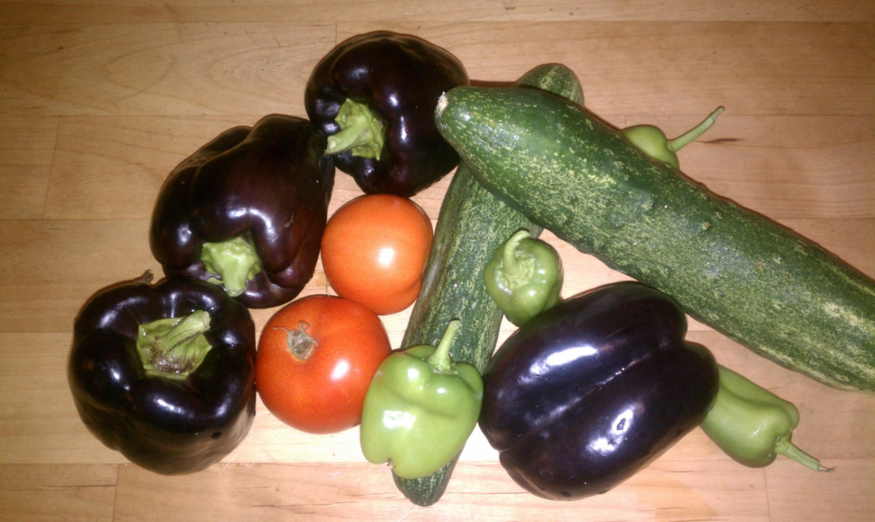
Harvesting the rewards…………….
“To dig in the mellow soil – to dig moderately, for all pleasure should be taken sparingly – is a great thing. One gets strength out of the ground as often as one touches it with a hoe.”
Charles Dudley Warner

Slide 11
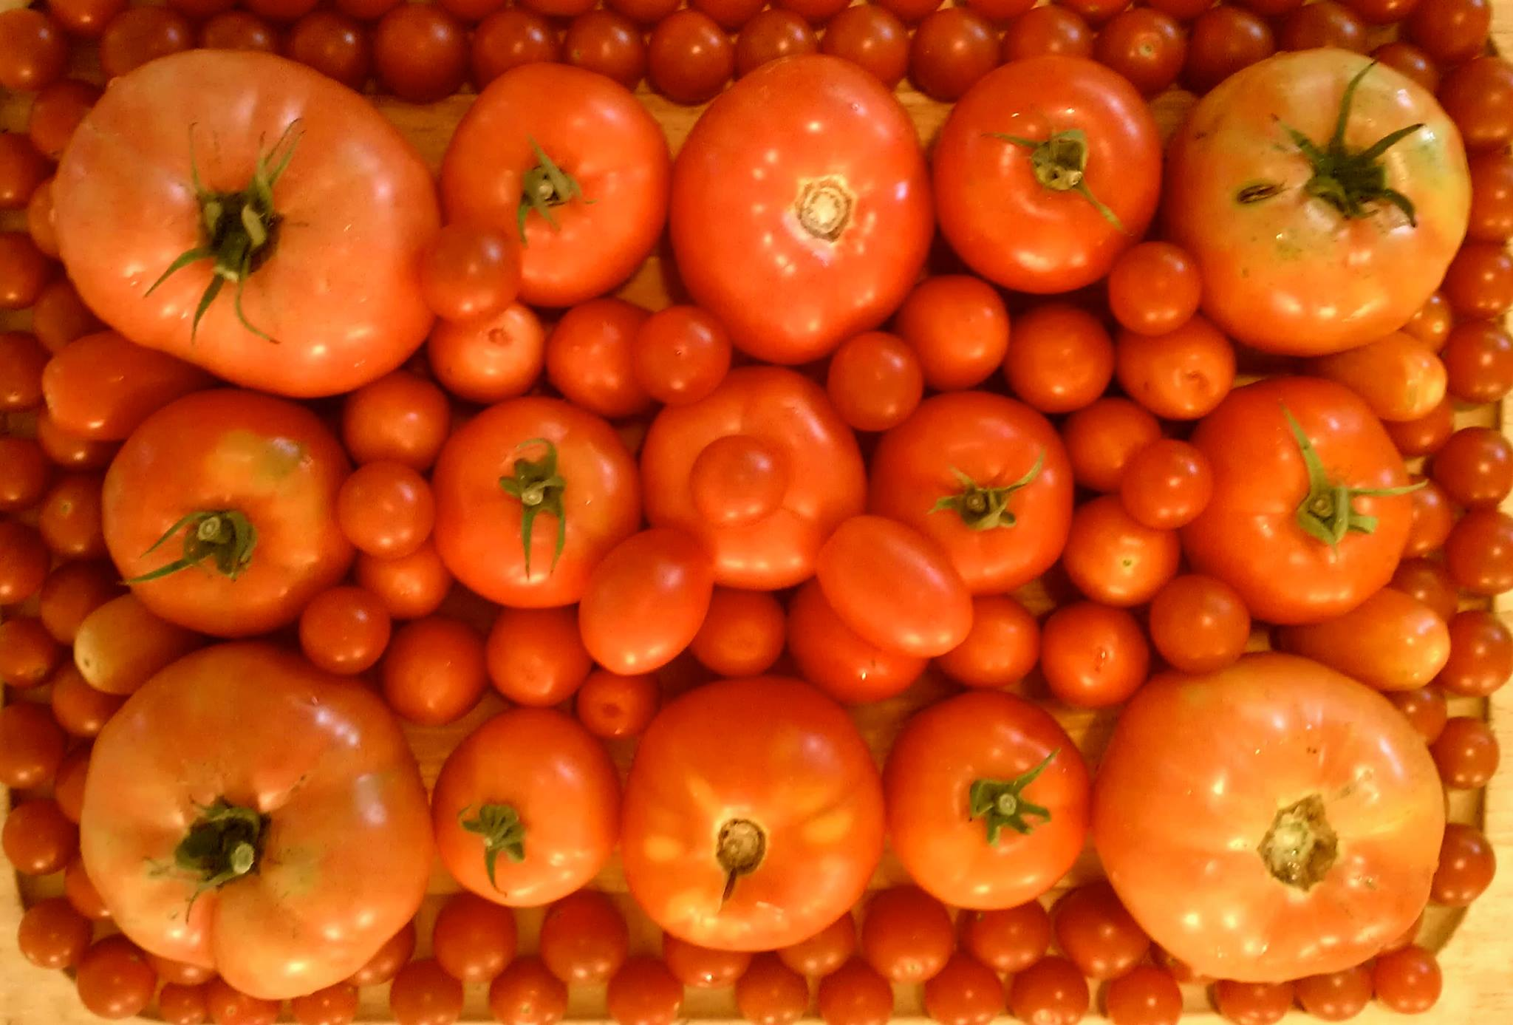
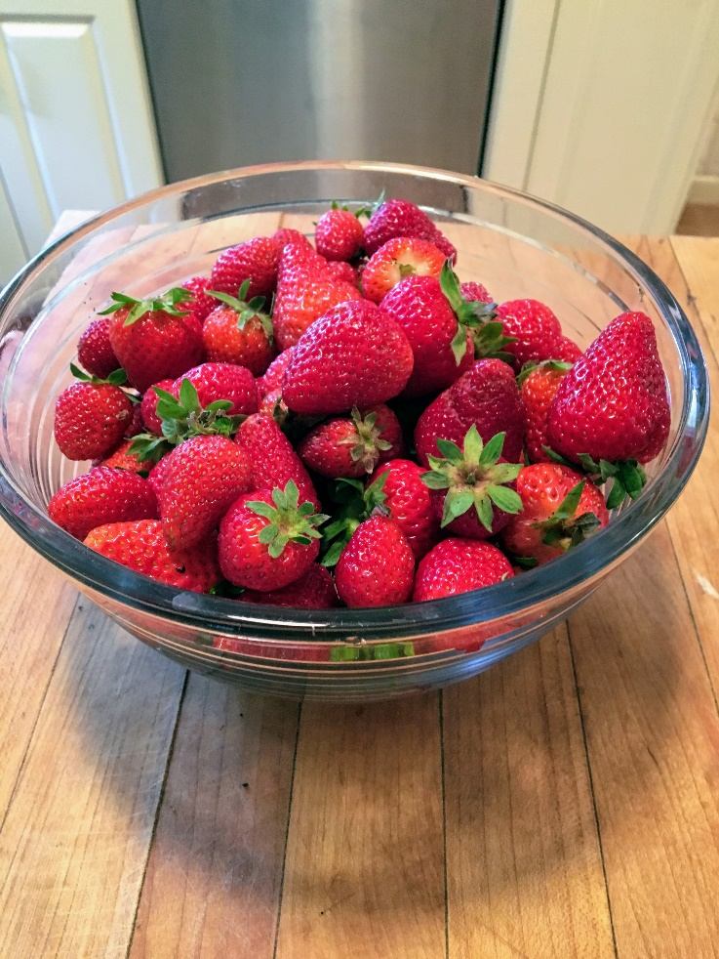
June/July

Slide 12
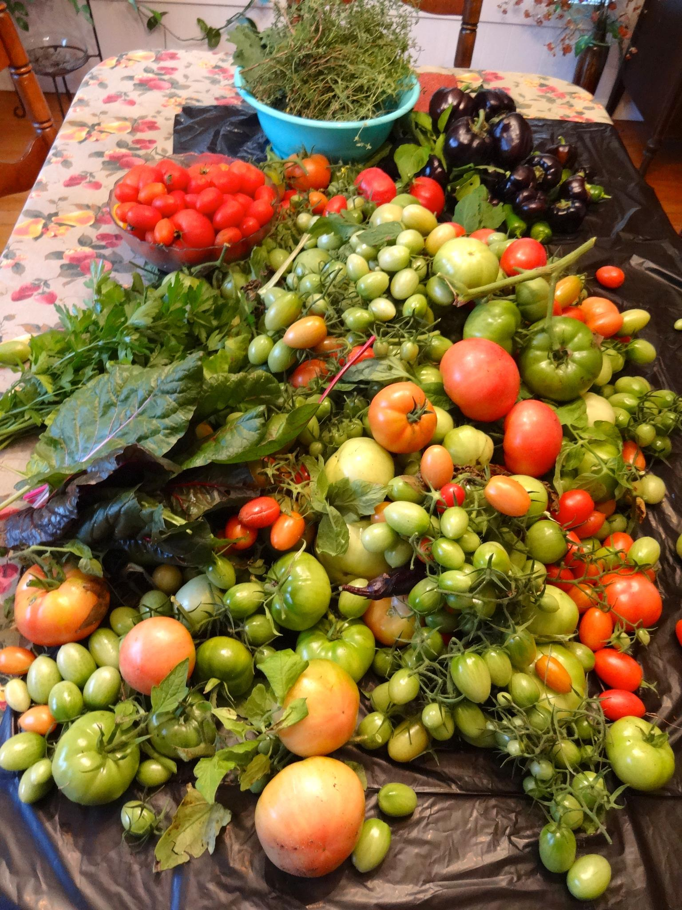
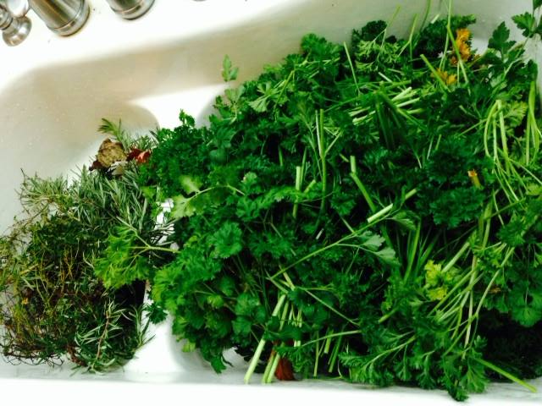
August - November

Slide 13
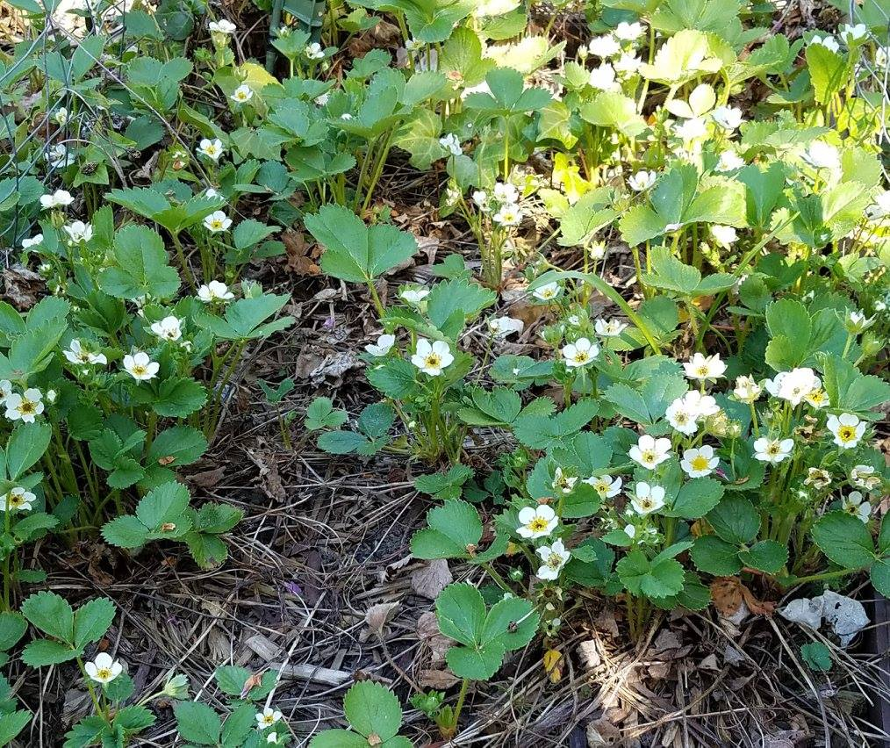
Hoe while it is Spring and enjoy the best anticipations. It is not much matter if things do not turn out well.
In order to enjoy agriculture you do not want too much of it, and you want to be poor enough to have a little inducement to work moderately yourself.
Charles Dudley Warner

