Slide 1
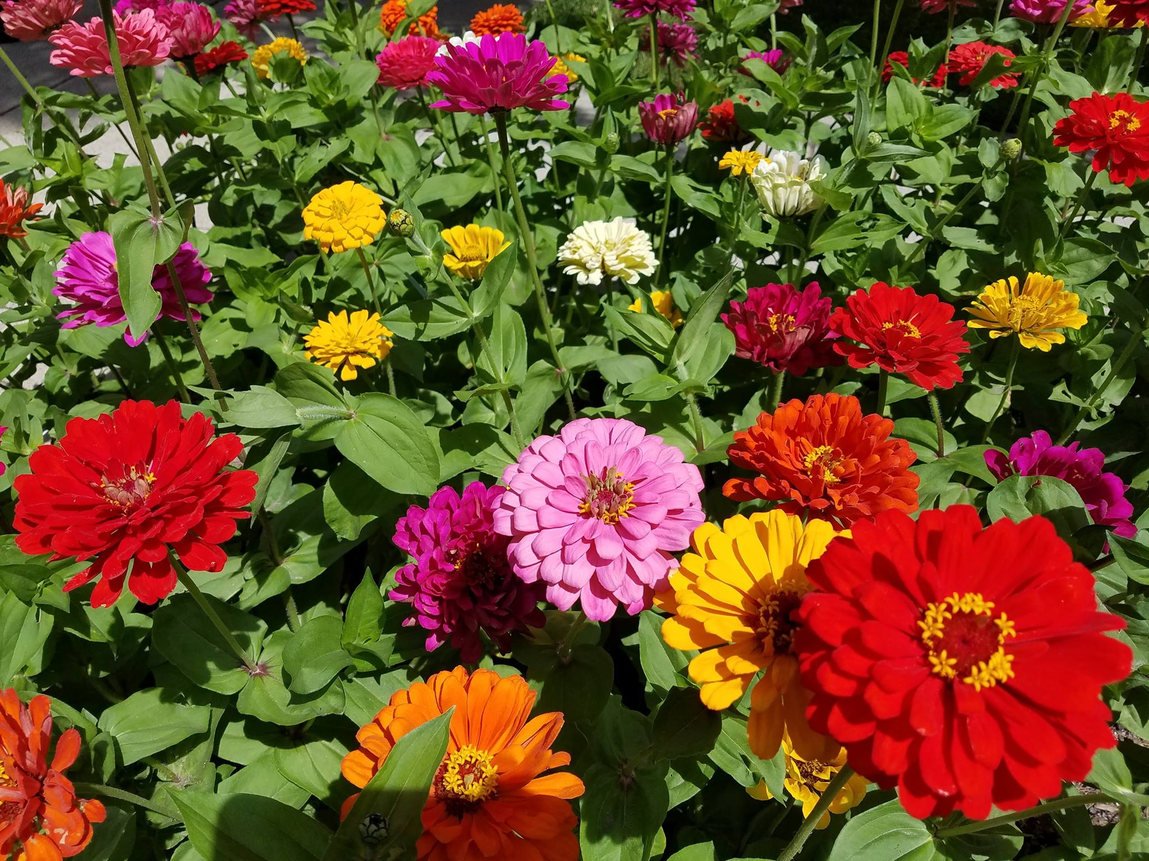
Planting for the Pollinators
Feeding the bees
So that we can continue to feed ourselves

Slide 2
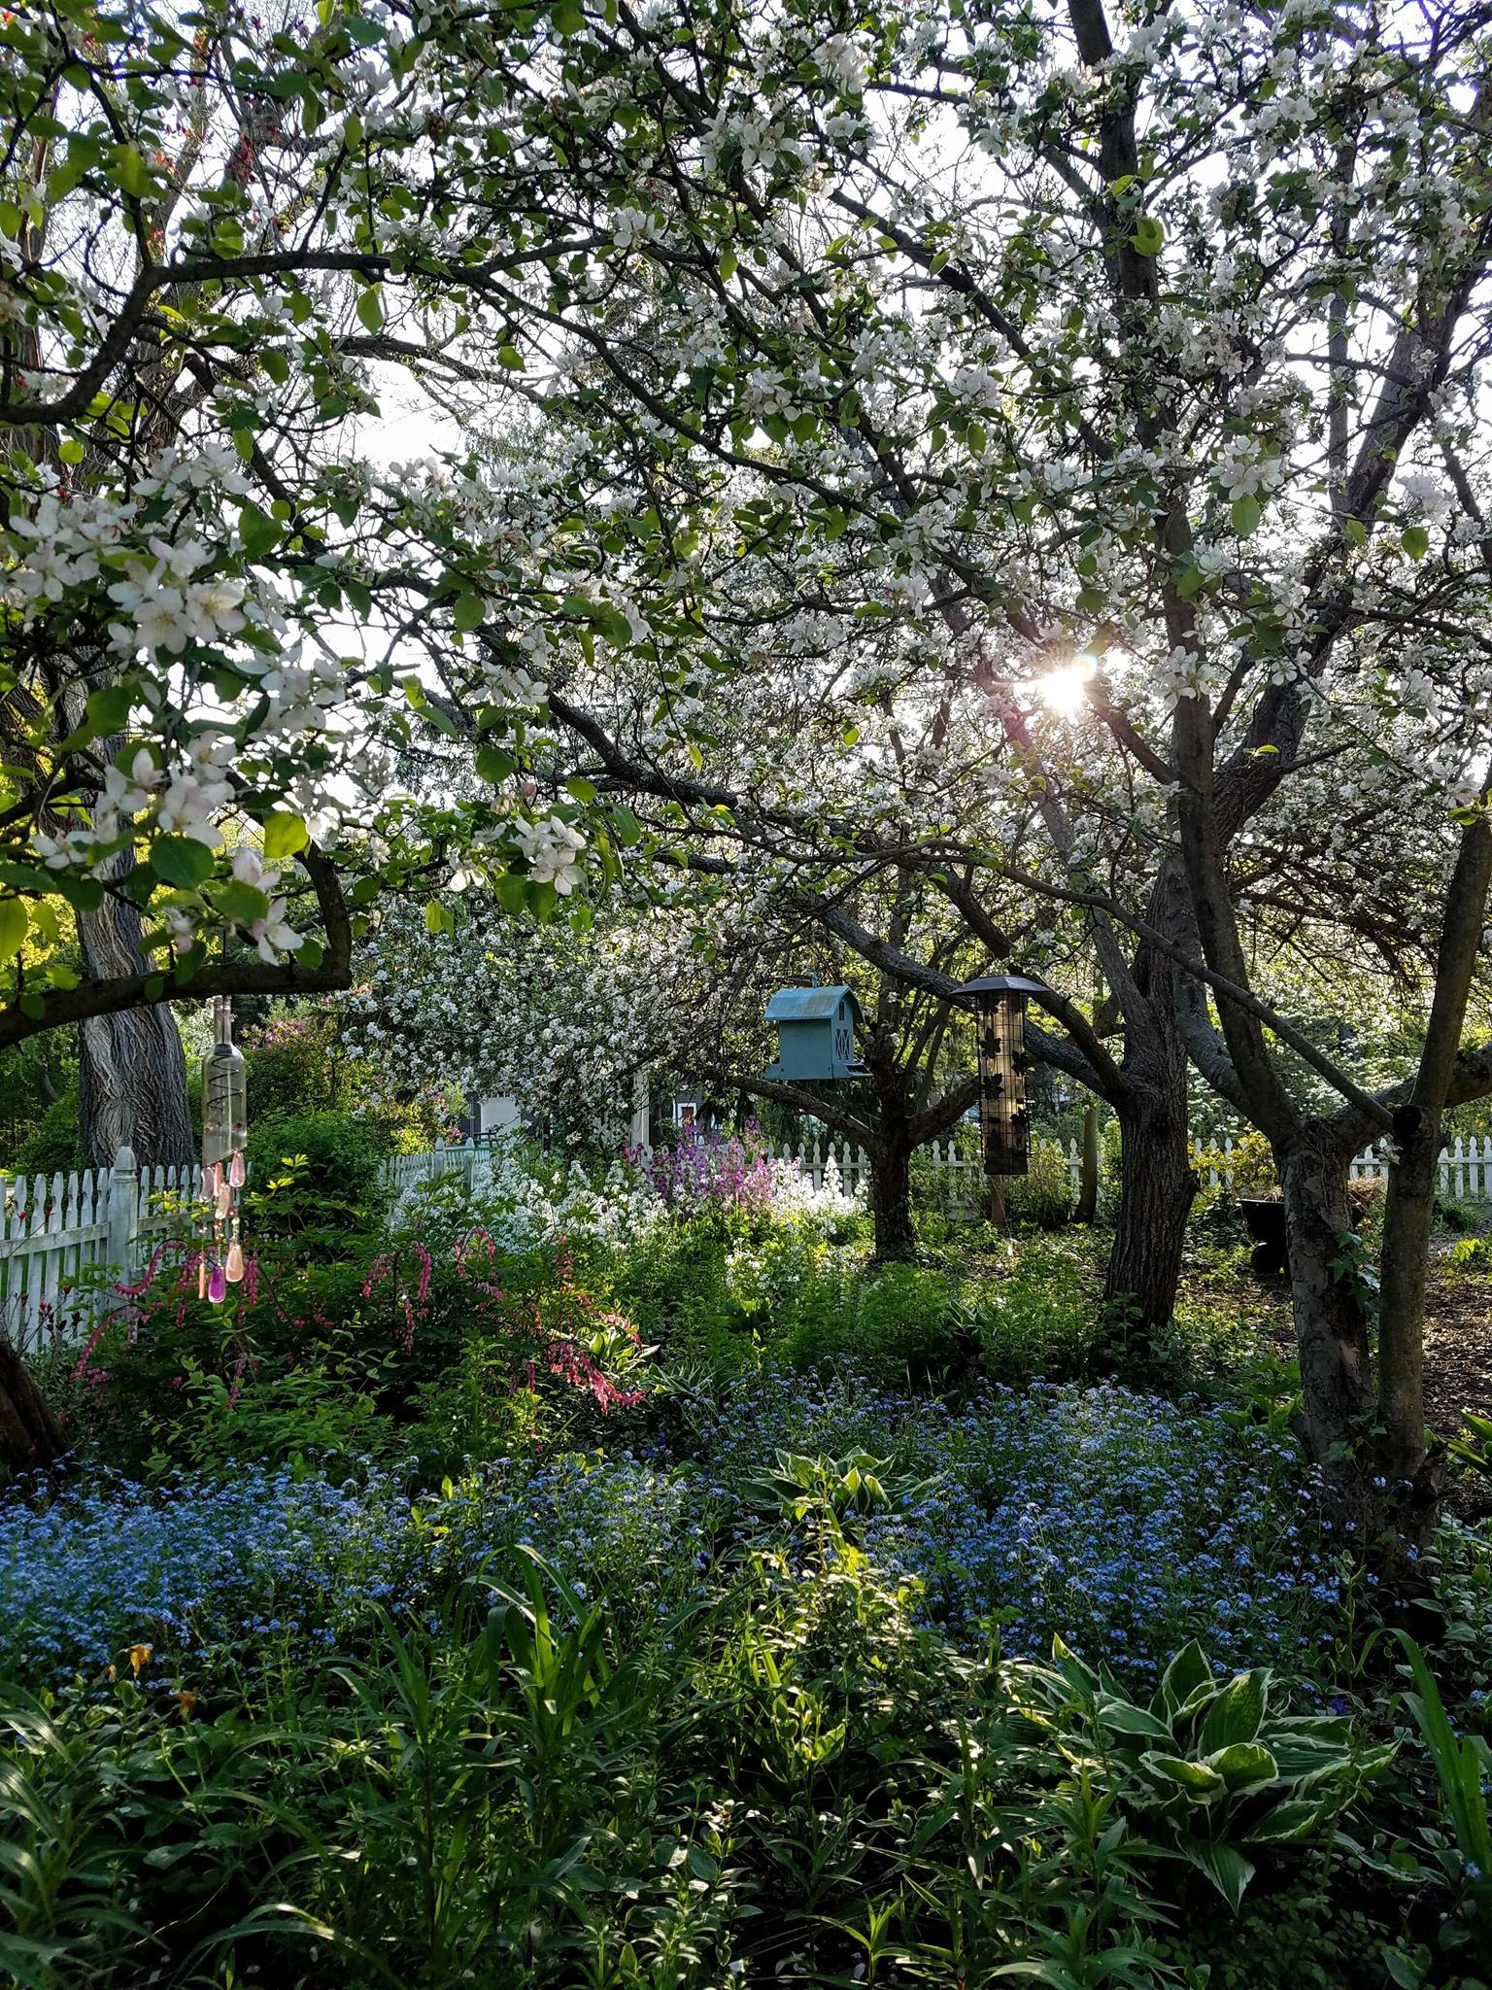
Flowering Fruit Trees

Slide 3
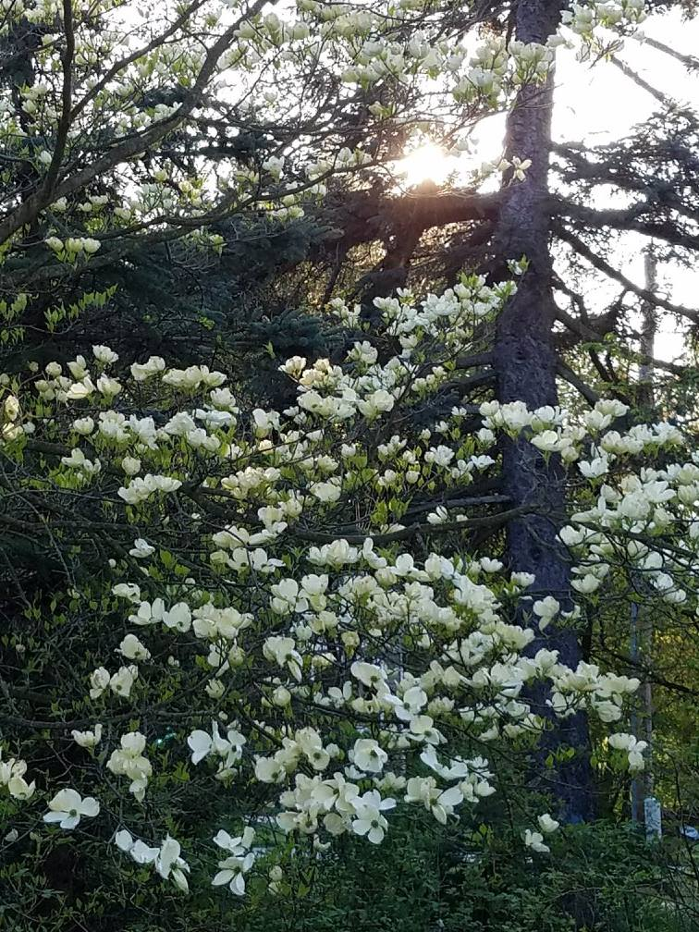
Flowering Trees

Slide 4
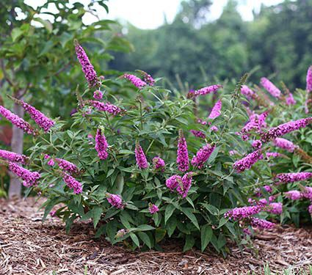
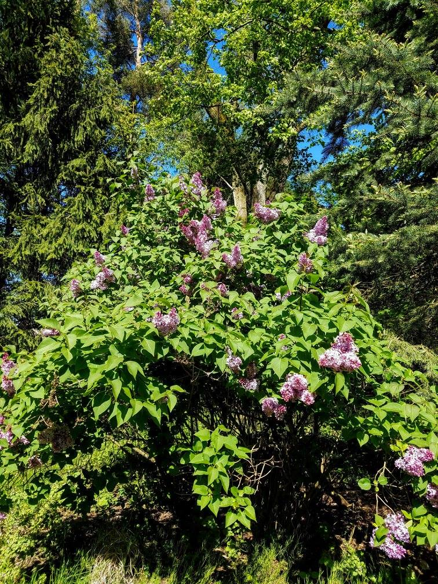
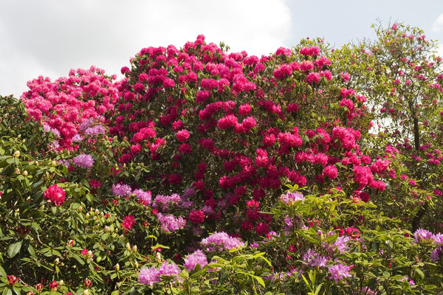
Shrubs
Buddleia
Lilac
Rhododendron

Slide 5
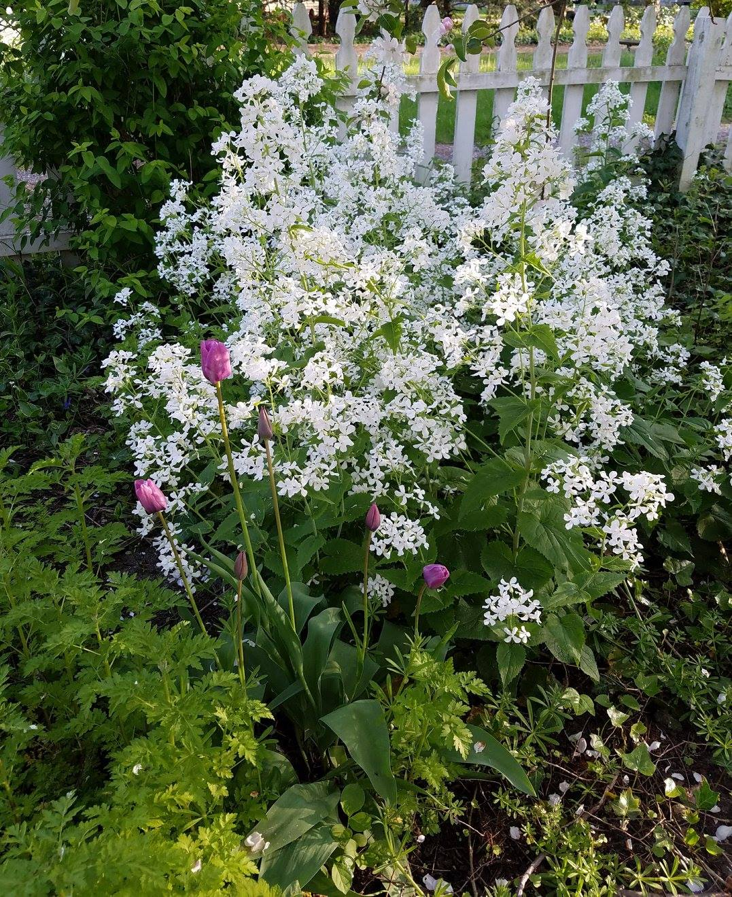
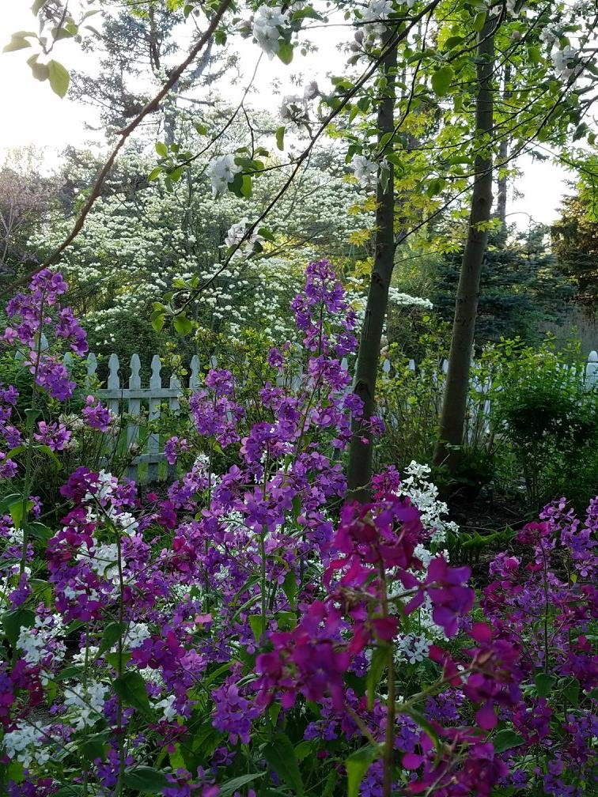
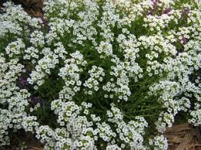
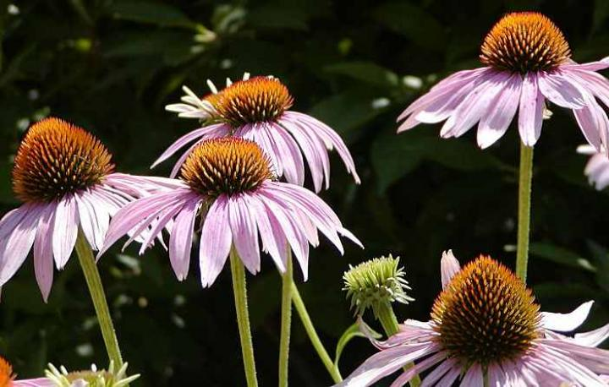
“Most perennials that produce lots of flowers over a long bloom period are very good for pollinators.”
Sweet Alyssum
Phlox
Corn Flowers

Slide 6
The following plants were found to be “extremely attractive” to pollinators in study published by the University of Sussex, UK, in 2014
Genus
Common Name
Organum
Agastache
Lavandula × intermedia
Nepeta
Echium
Salvia
Borago
Dahlia
Oregano
Anise hyssop
Lavender
Catmint
Viper’s bugloss
Salvia
Borage
‘Bishop of Oxford’ Dahlia

Slide 7
Pollinator Health Meetings – MSU Extension
Pollinator Health Meetings
Date: May 9, 2018
Time: 6 - 8 p.m.
Location: Board Room at the Ottawa County Fillmore Complex, 12220 Fillmore Street, West Olive, MI 49460
Contact: Duke Elsner, 231-922-4822, elsner@msu.edu; Carlos Garcia-Salazar, (616)-994-4580, garcias4@msu.edu
2018 Bee Palooza
Date: June 24, 2018
Time: 1-4 p.m.
Location: Michigan State University Horticulture Gardens, 1066 Bogue St, East Lansing, MI 48824
Contact: bpalooza@msu.edu

Slide 8
Resources
Allegan County Conservation District
https://allegancd.org/
MSU Extension: Pollinators and Pollution
https://www.canr.msu.edu/pollinators_and_pollination/
Crown Bees – The Native Bee Experts
https://crownbees.com/
University of Minnesota: Bee Lab Directed by Marla https://www.beelab.umn.edu/meet-us/dr-marla-spivak

Slide 9
Suggested Reading
Attracting Beneficial Insects with Native Flowering Plants
Published by the Michigan State University Extension
MASON BEE REVOLUTION: How The Hardest Working Bee Can Save The World, One Backyard at a Time
By Dave Hunter and Jill Lightner

