Slide 1


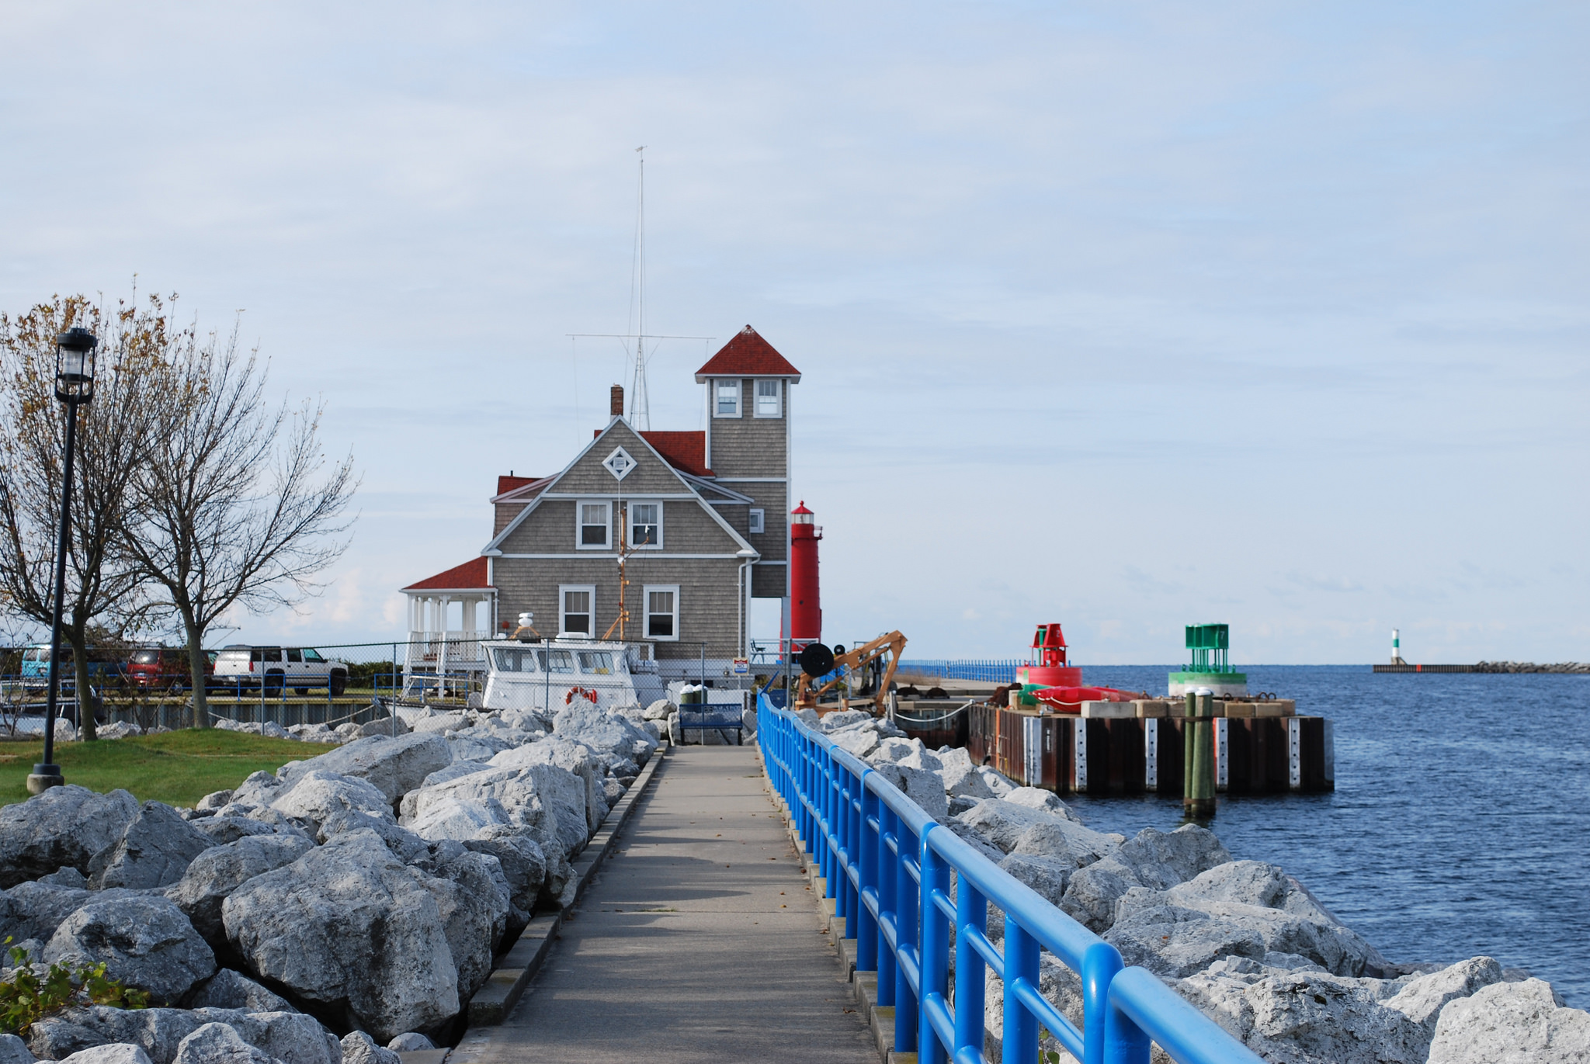

Slide 2
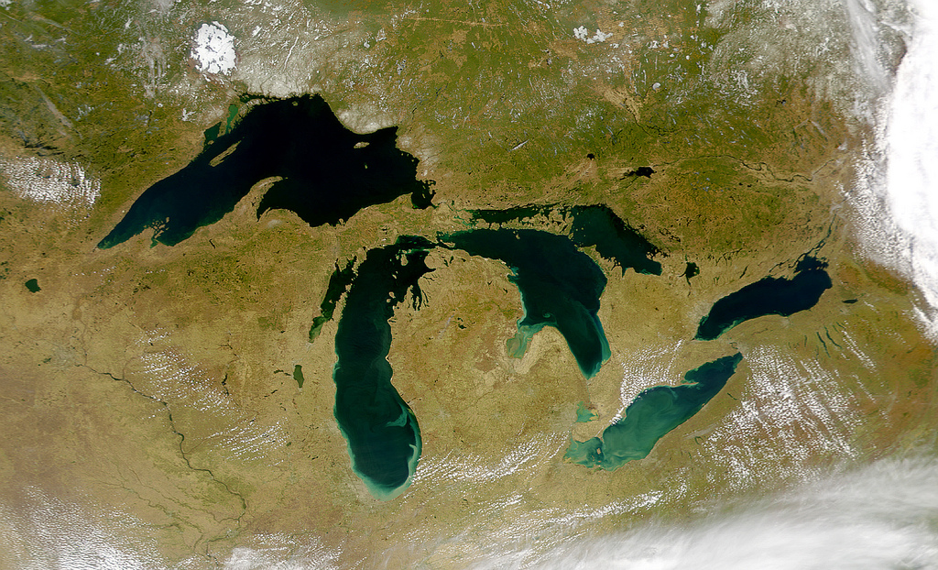


NOAA's Mission: Science, Service, and Stewardship

Slide 3
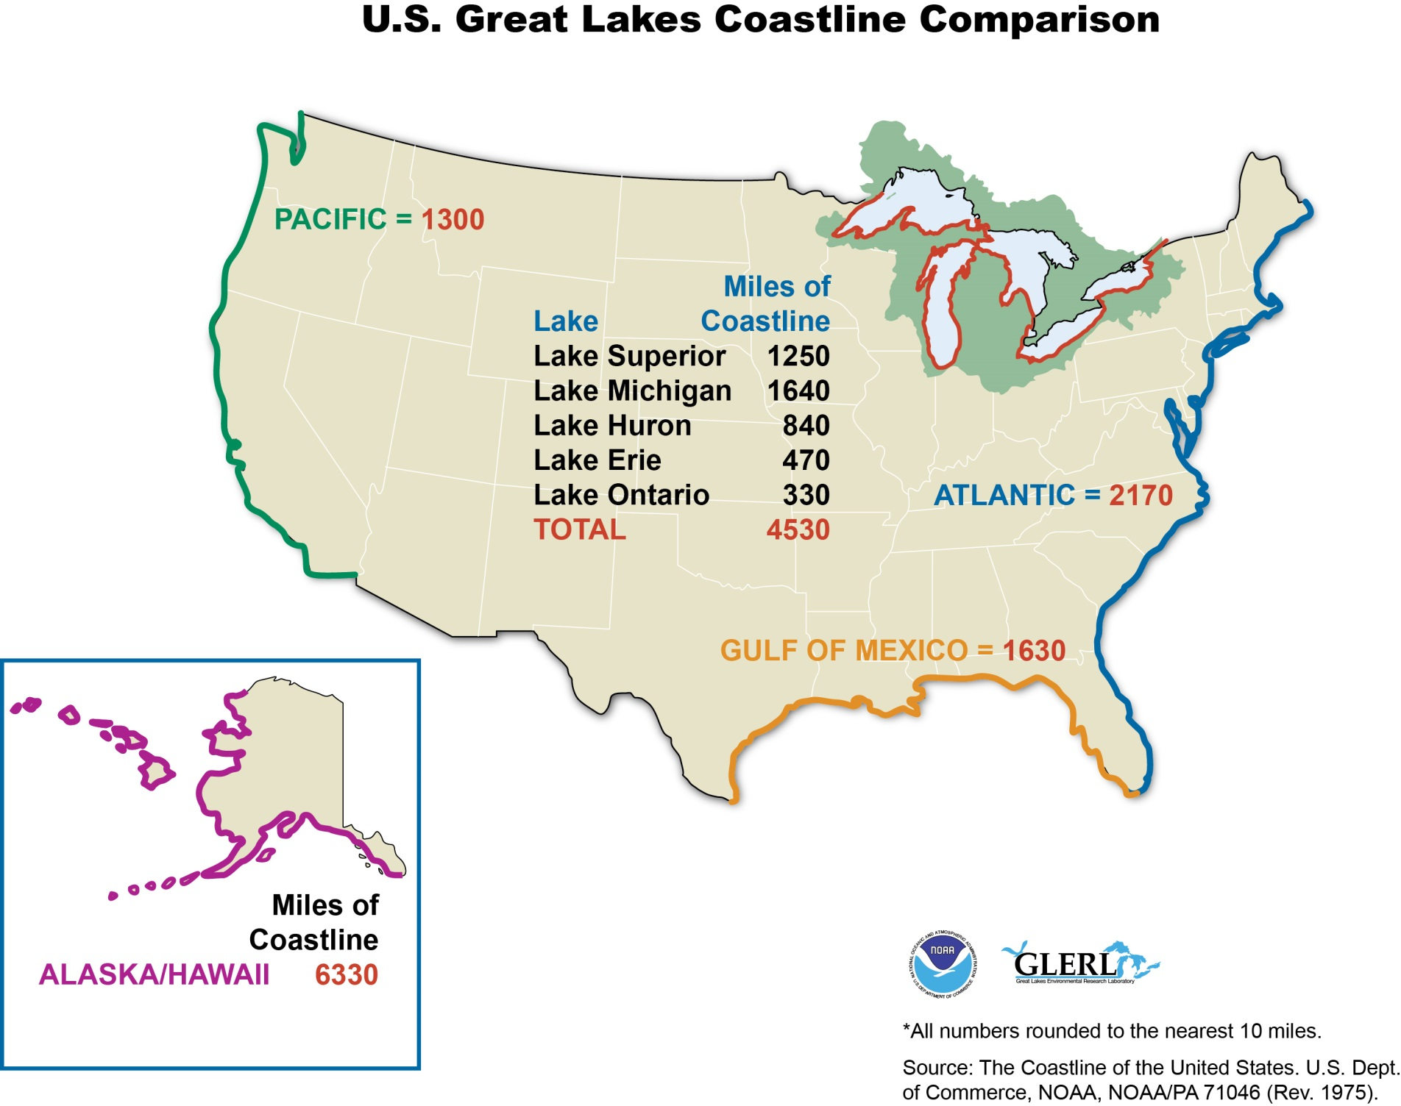

Slide 4
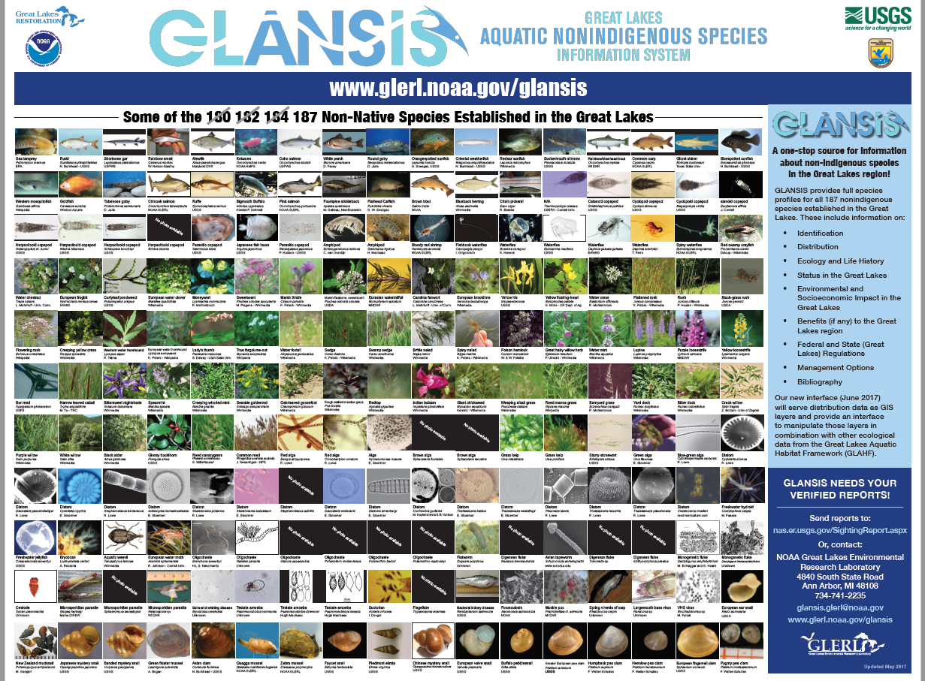

Slide 5
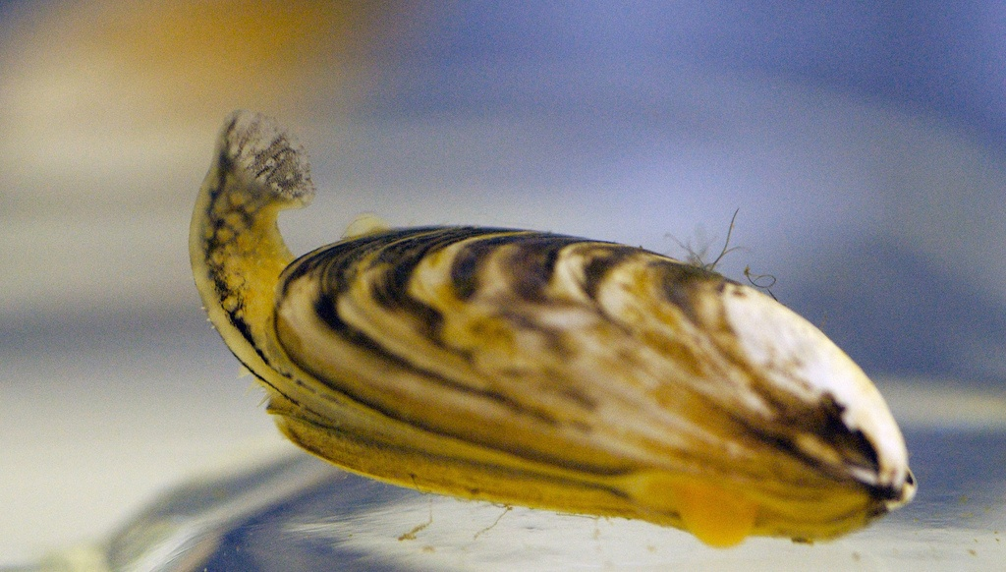
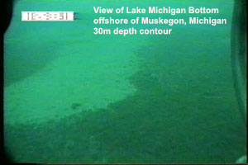

Slide 6
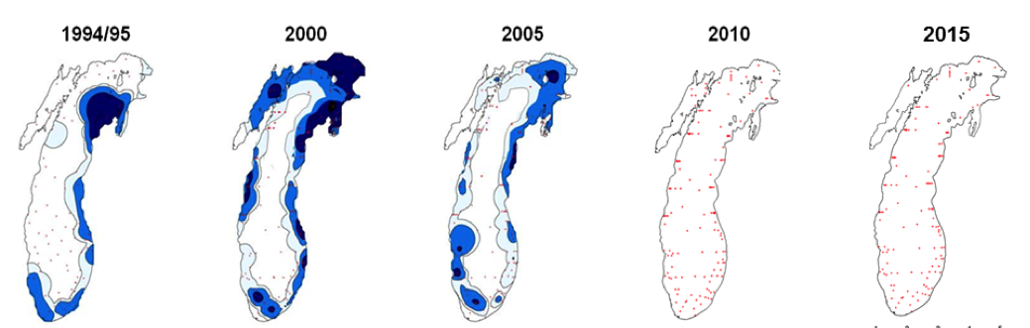
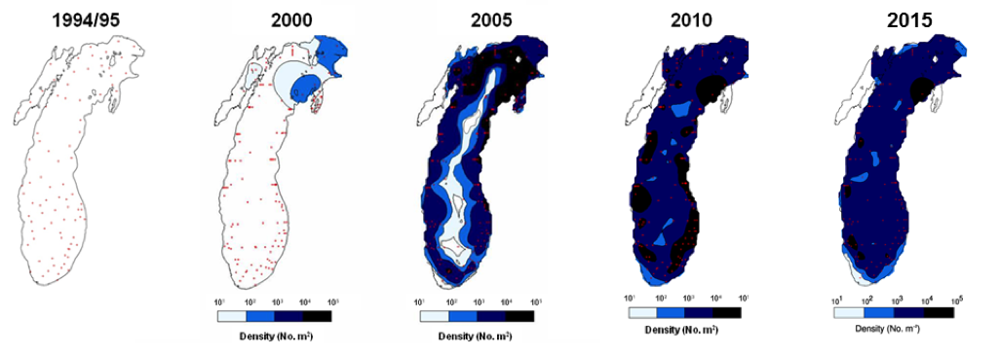
Dreissenid Mussels in Lake Michigan- Density
Quagga Mussels Zebra Mussels
Provided by Ashley Elgin NOAA GLERL

Slide 7
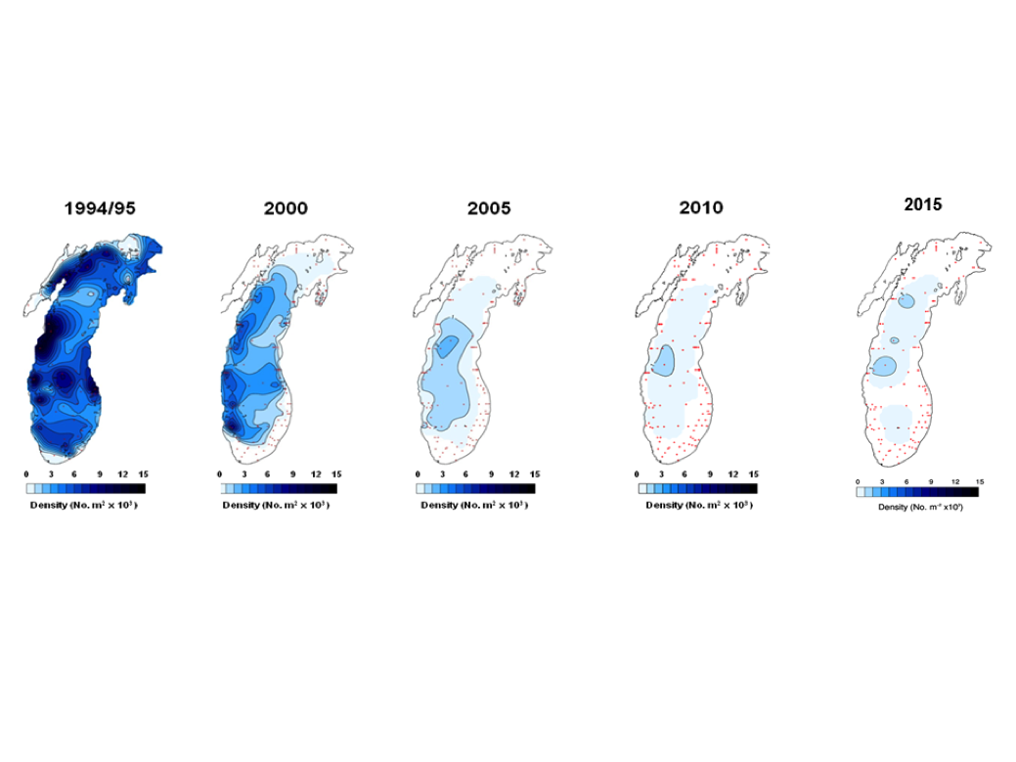

Rapid declines in abundance of the amphipod Diporeia
Historically, a high energy food source for many fish
Provided by Ashley Elgin NOAA GLERL

Slide 8
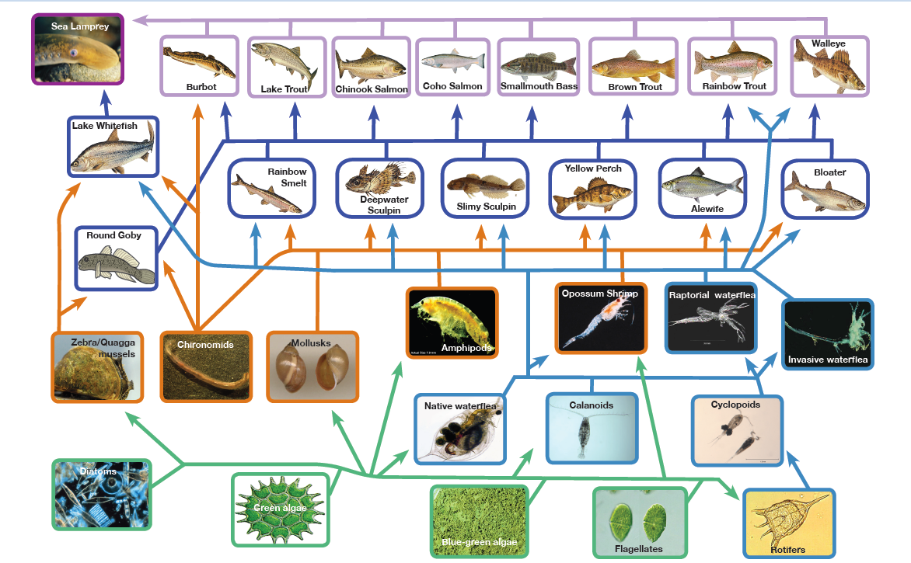
Lake Michigan Food Web

Slide 9
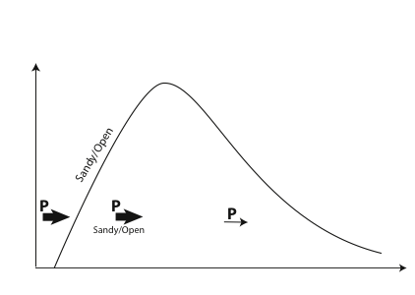
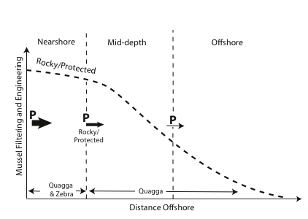
Impact of dreissenid mussels
Nearshore vs Offshore Dichotomy
Provided by Henry Vanderploeg NOAA GLERL

Slide 10
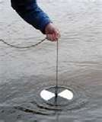
Spring-offshore
Secchi (m)
Mussels reduce productivity of the offshore regions
Intercept nutrients transported from nearshore
Direct filtering (isothermal periods)

Slide 11
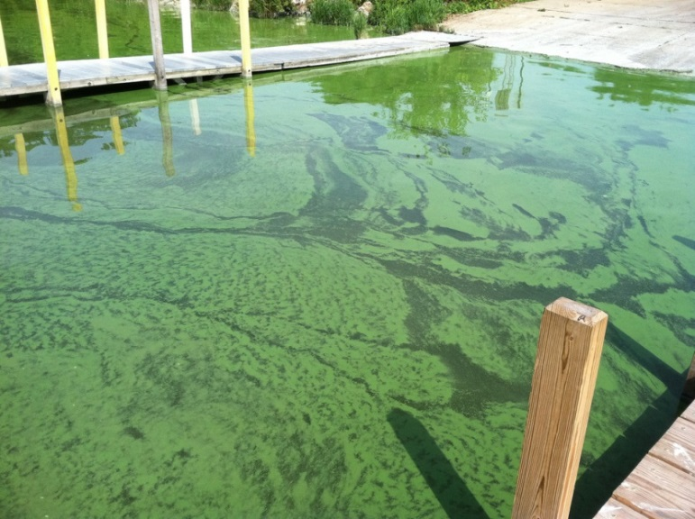

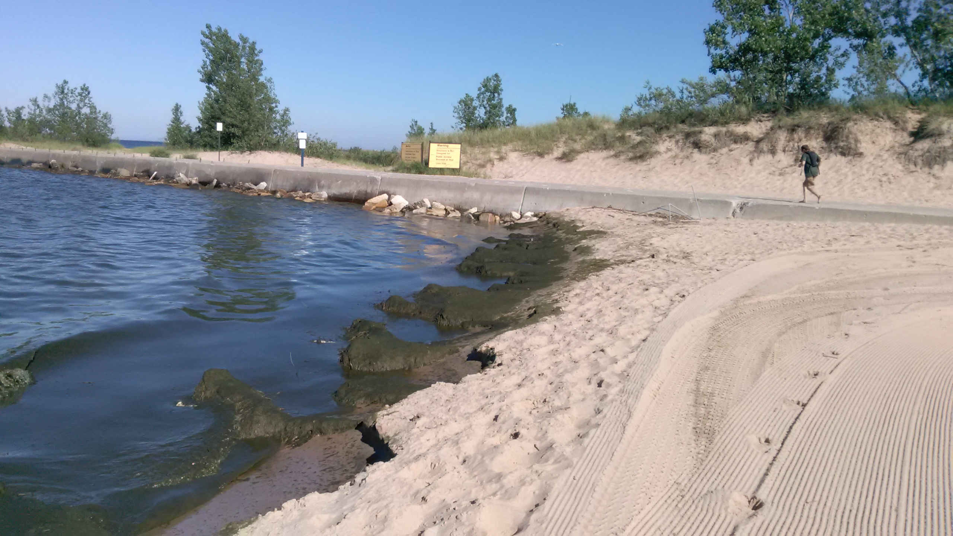
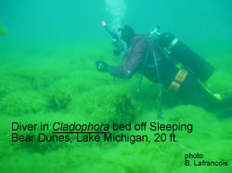
Mussels create management dilemmas in nearshore regions
Promote Harmful Algal Blooms
Promote Filamentous Algae Production

Slide 12
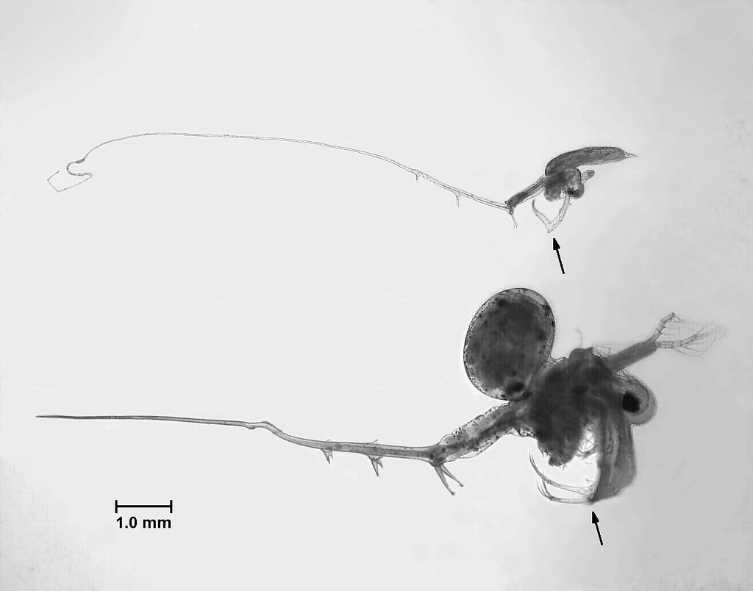
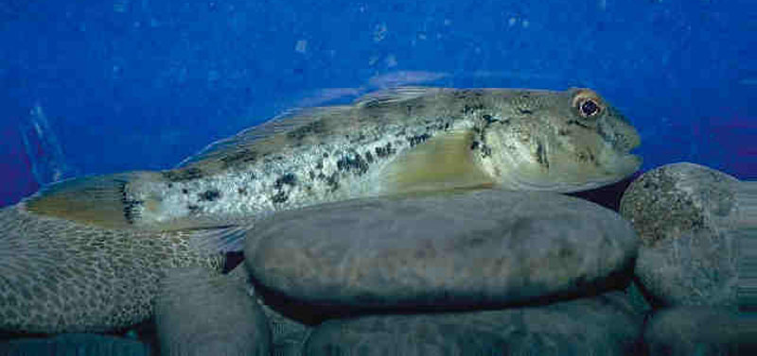
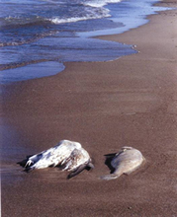
Mussels facilitate other ecological problems
D. Jude
Facilitate invasions of other species (Round goby)
Enhance impacts of other invasive species (spiny water fleas)
Alter light environment
Associated with avian botulism outbreaks

Slide 13
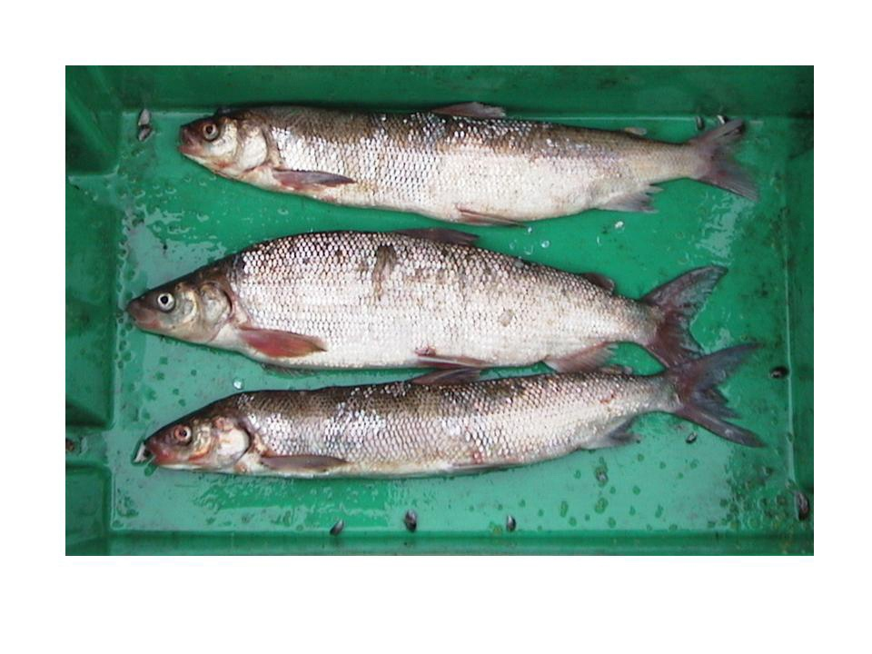
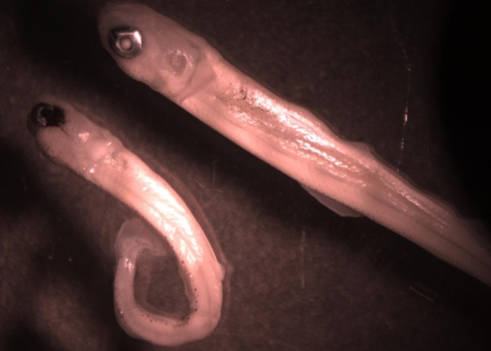
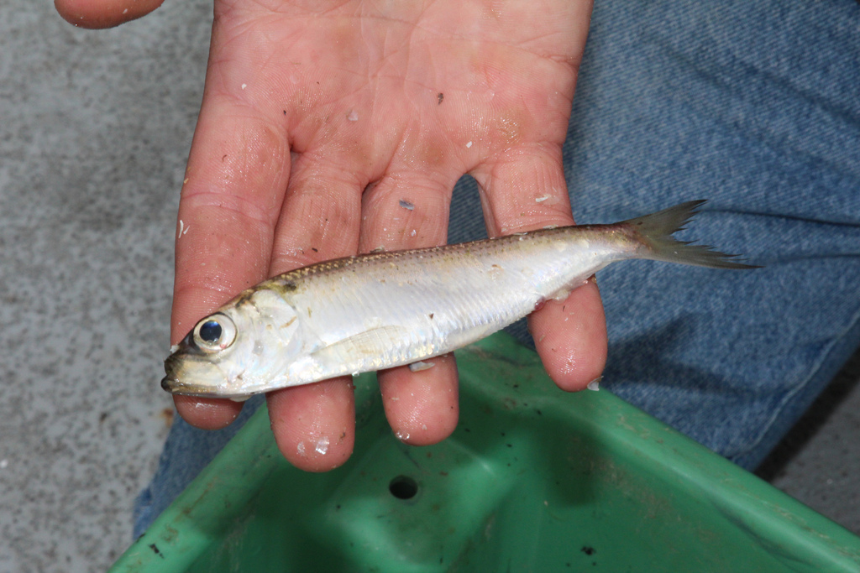
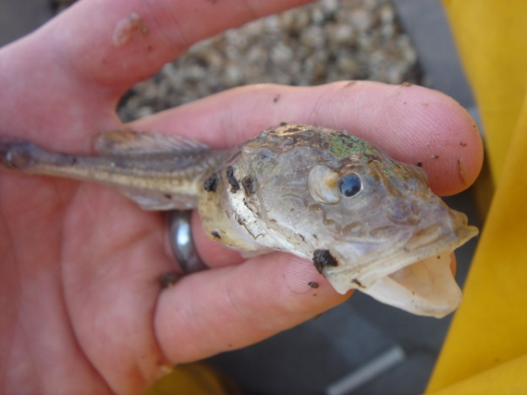
Declines in fish condition and growth

Slide 14
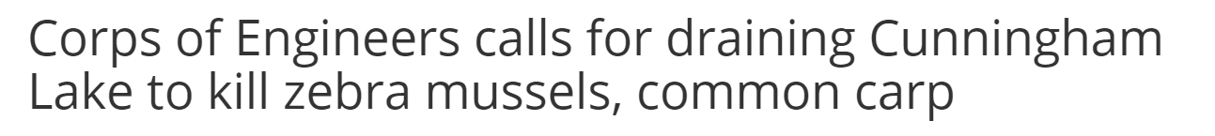
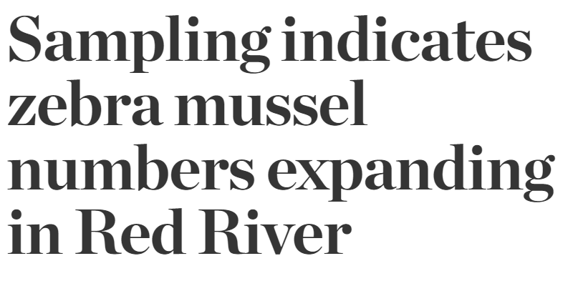
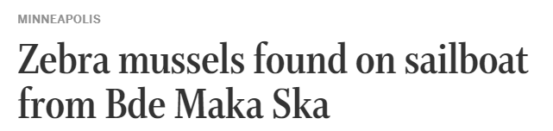
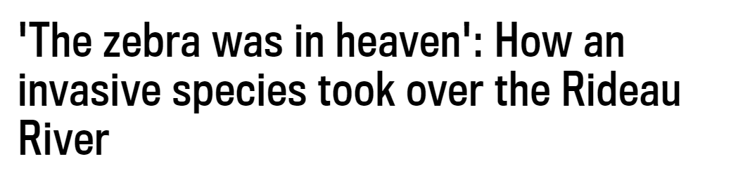
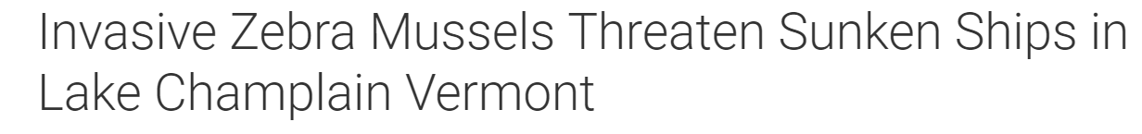
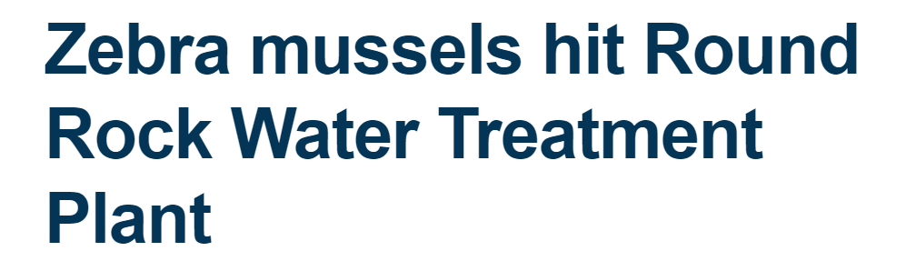
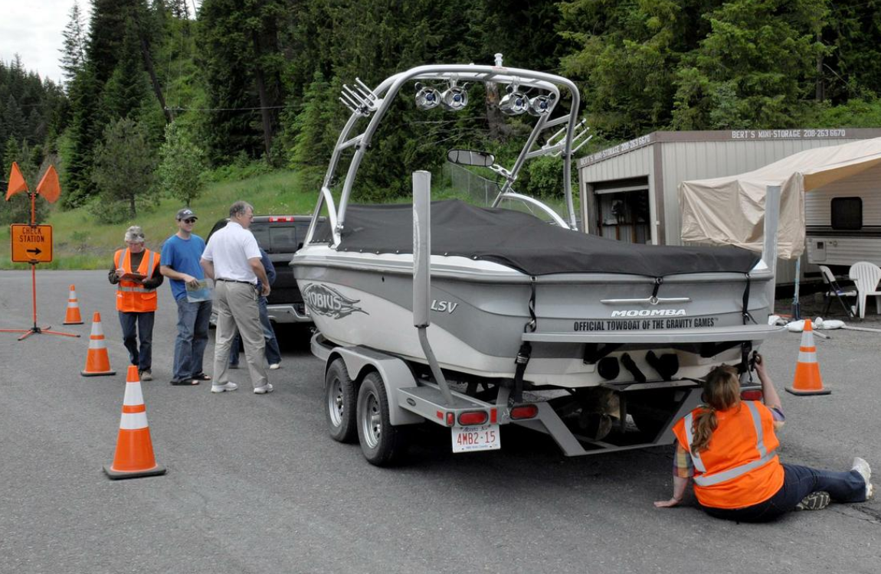

Mussels spread across the country: ecological and economic costs
Star Herald 9/27/18
KFGO Radio 10/1218
Minneapolis Star Tribune 10/8/18
NECN 10/8/18
Ottawa Citizen 10/3/18
KBTC TV 10/11/18
Daily Sentinel 10/11/18

Slide 15


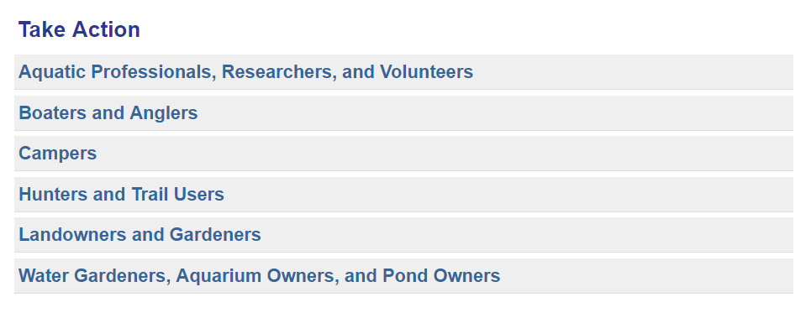
www.michigan.gov/invasives

Slide 16



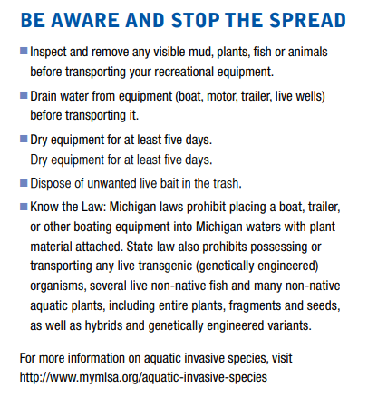


Slide 17
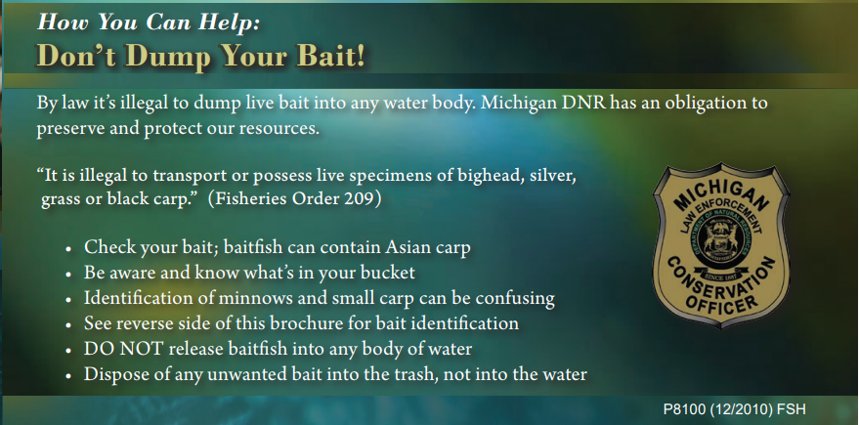

17

Slide 18






Keeping Informed
Healing our Waters-
Great Lakes Coalition

Slide 19


Report New Findings

Slide 20
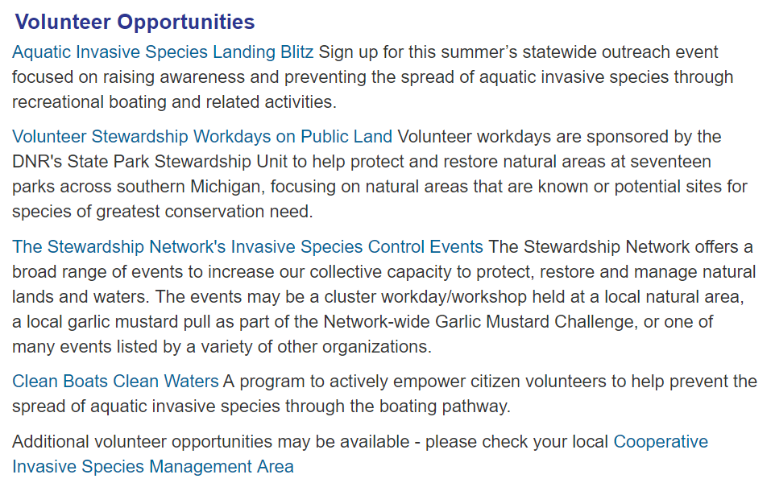
www.michigan.gov/invasives

